Slide 1
Soft hands for hard professions. Moldovan female archaeologists in time
Mariana Vasilache National Museum of History of Moldova
Nessebar, October 10-12, 2022

Slide 2
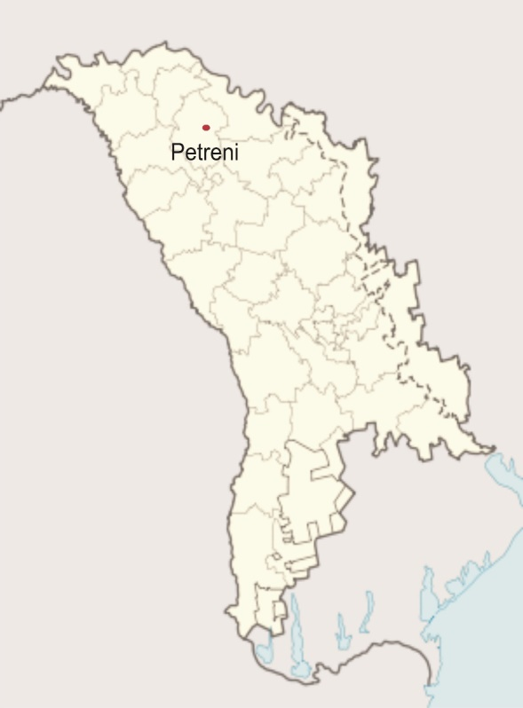
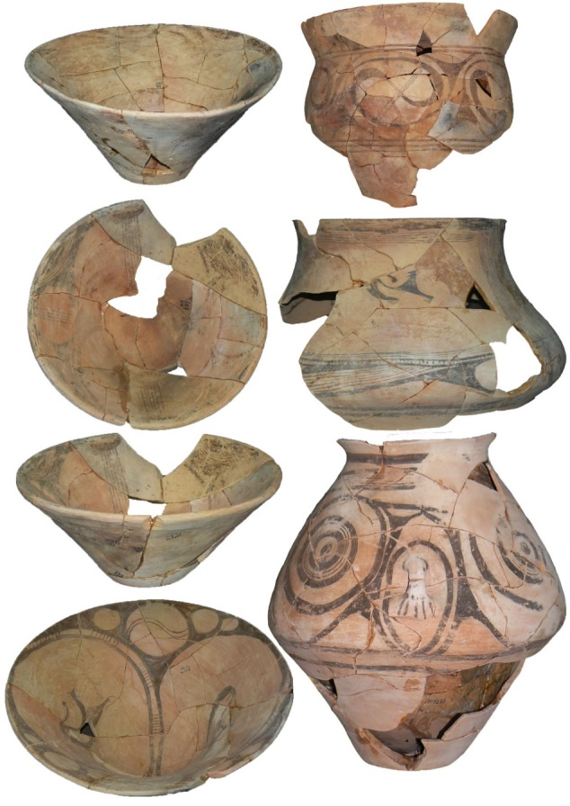
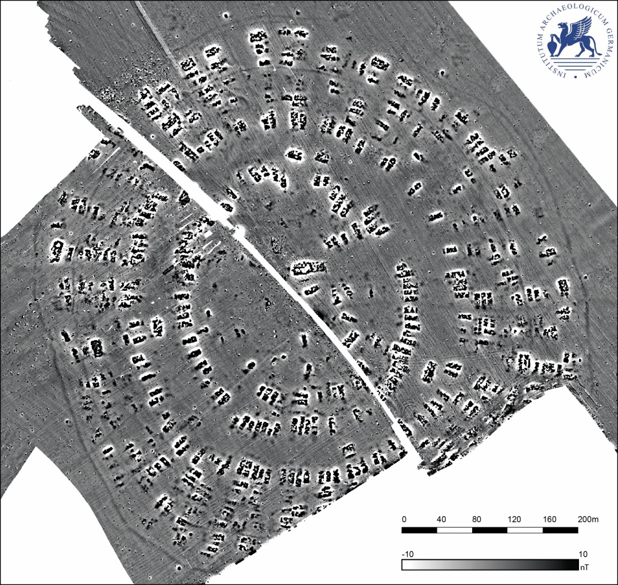
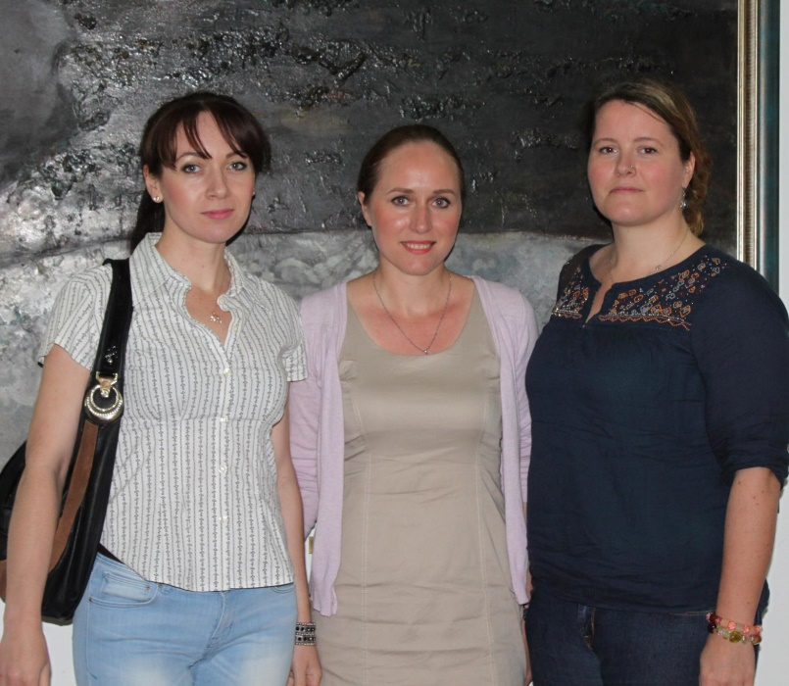
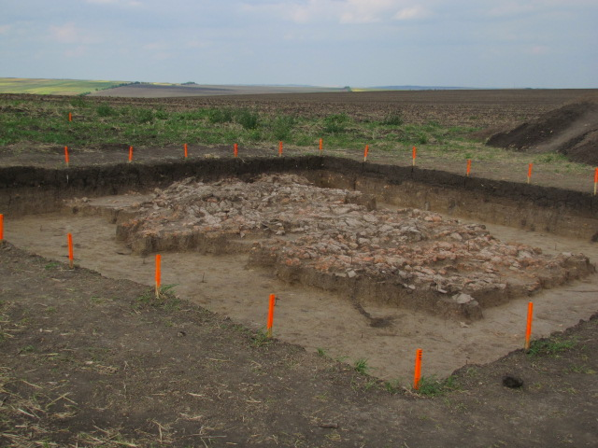
Petreni
Elena Buznea
1901
2011-2015

Slide 3
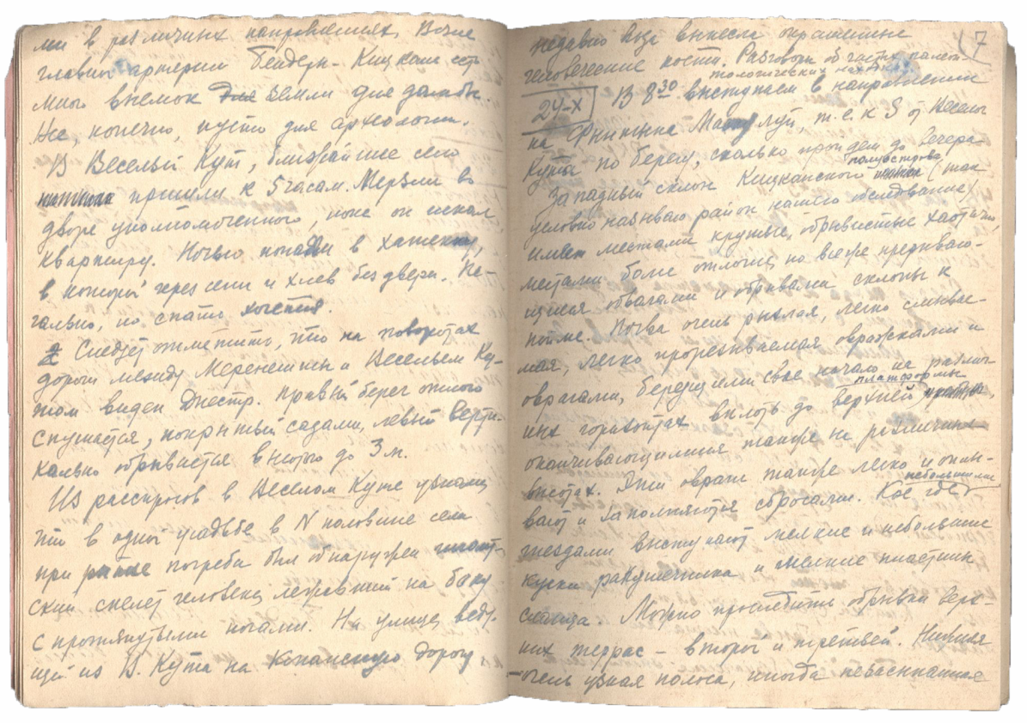
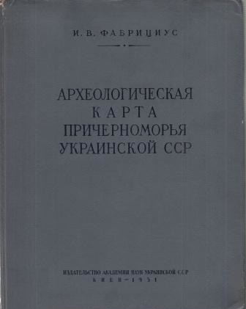
Irina Fabricius 1882, Kiev – 1966, Saint Petersburg
Specialist in the history and culture of steppe Scythian tribes and the population of forest-steppe Ukraine of the Scythian era.

Slide 4
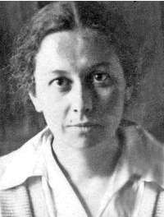
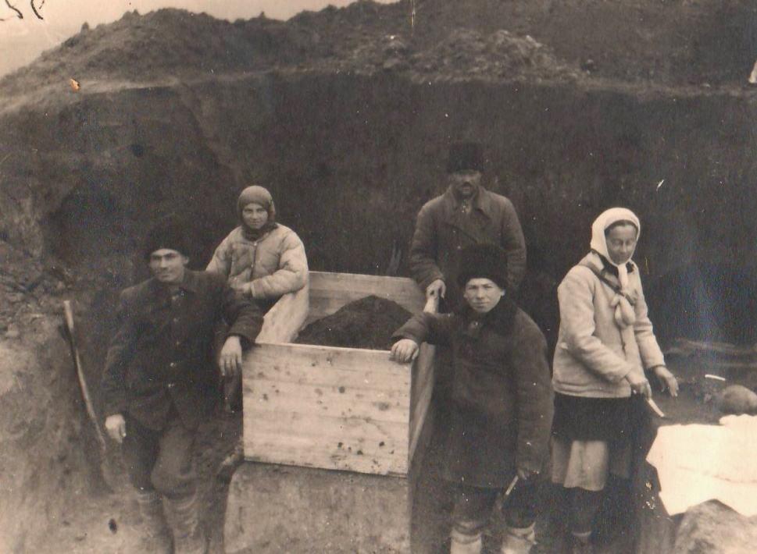
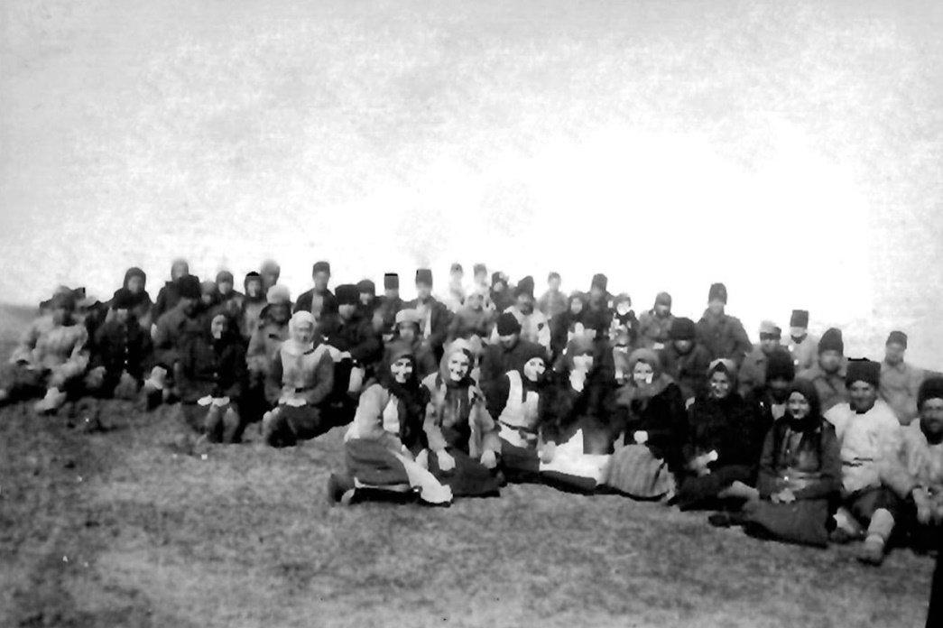
Tatiana Oboldueva Kiev, 1908-1995
October – November, 1946

Slide 5
Russian archaeologist, Passek studied at Leningrad University, then worked at the State Academy for the History of Art and the USSR Academy of Sciences’ Institute of Archaeology. From 1934 she took part in or led archaeological expeditions in the Ukrainian SSR and the Moldavian Autonomous Soviet Socialist Republic on sites from the Trypillyan era, most notably the Kolomyishchyna archaeological sites. Passek put forth a scheme for the periodization of Trypillyan culture that gained and has retained broad acceptance. Her major works include Periodizatsiia tripol'skikh poselenii (A Periodization of Trypilian Settlements, 1949) and Rannezemledel'cheskie (tripol'skie) plemena Podnestrov’ia (Early Agricultural [Trypilian] Tribes of the Dnister Region, 1961).
Encyclopedia of Ukraine, vol. 3 (1993)
1903-1968

Slide 6
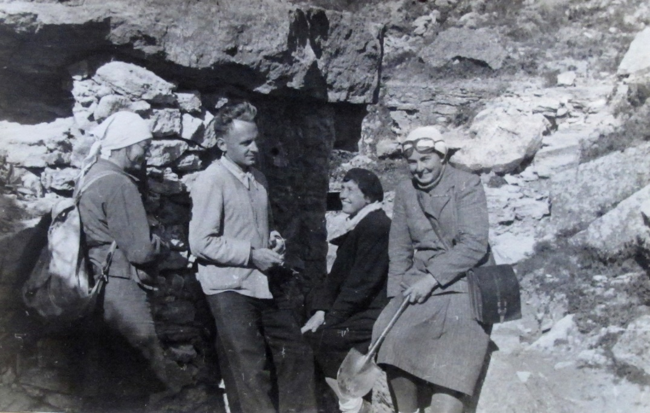
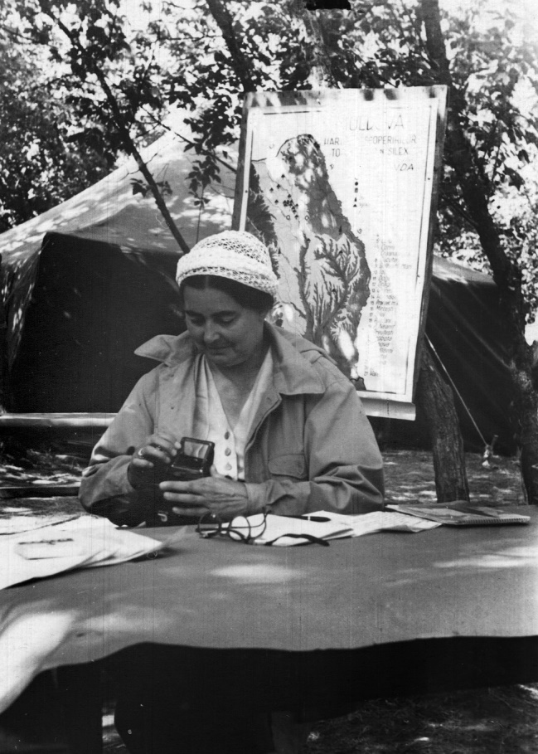
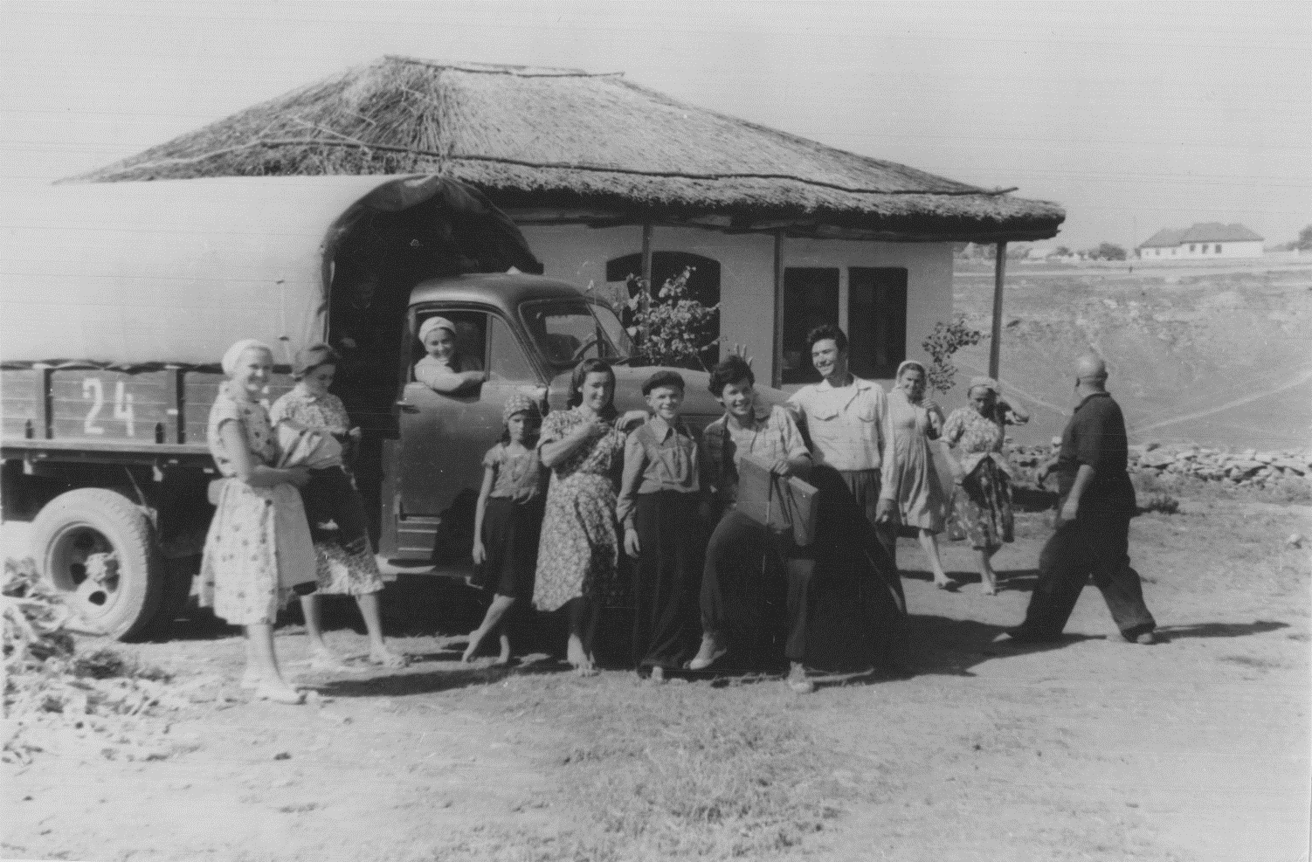
1954, Florești, Mărculești
Ofatinți, paleolithic station, 1947
1954, Alcedar

Slide 7
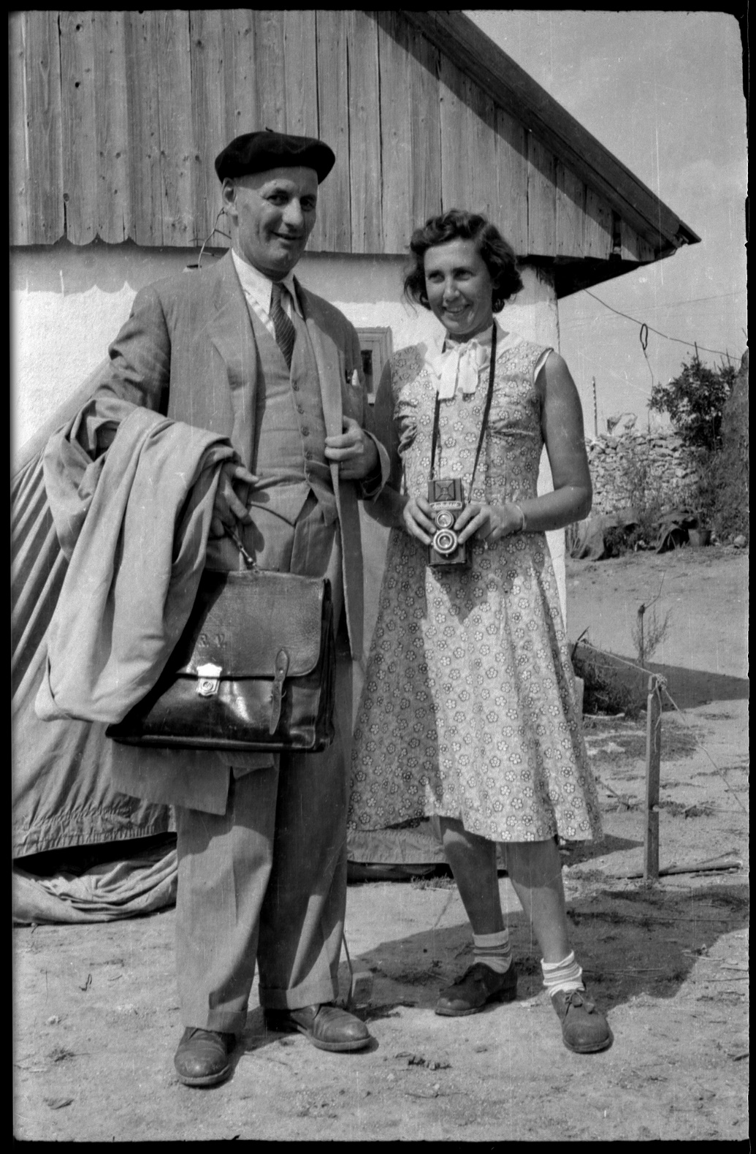
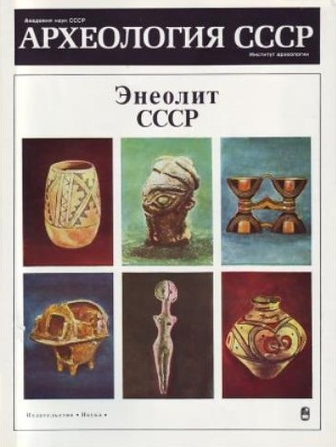
Ekaterina Cernysh
1957

Slide 8
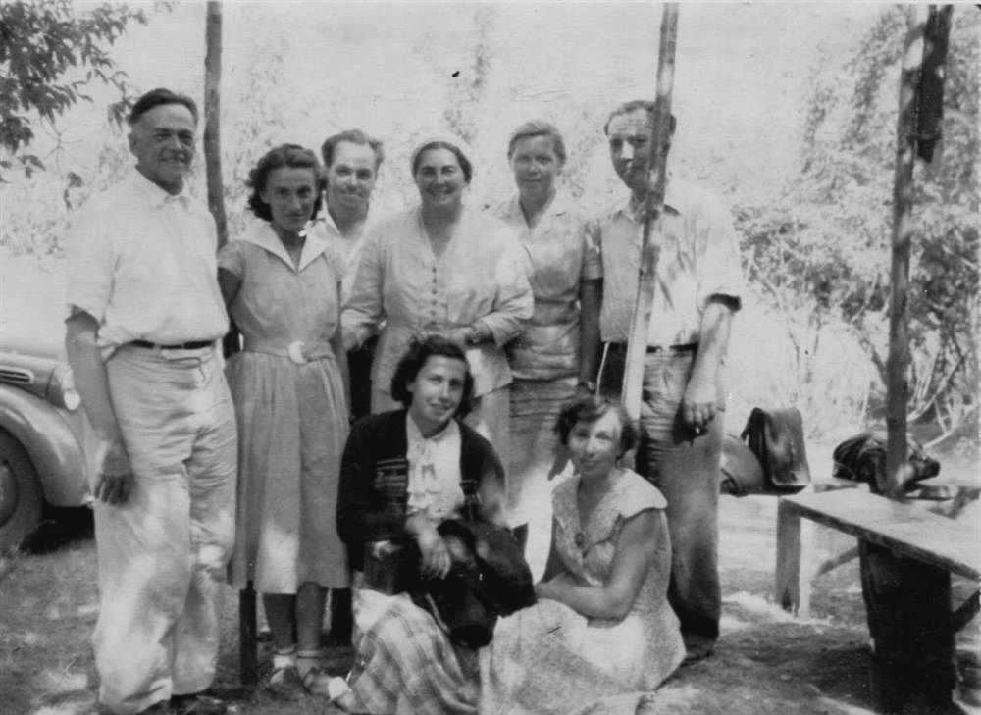
Tamara Movsha
Moldavian expedition, 1957. At the excavations of the village Alchedar leaded by G.B. Fedorov.
From left to right: Tarasenko (?), Maria Comșa (Bucharest), A.L. Mongait, T.S. Passek, A.I. Melyukova, G.B. Fedorov, E.K. Chernysh, T.G. Movsha.

Slide 9
Ana Meliukova
1921-2004
Historian, archaeologist, Scythologist, Doctor of Historical Sciences, head of the Moldavian expedition team, head of the Western Scythian expedition of the IA RAS. In 1945 she graduated from the Faculty of History of Moscow State University, studied in graduate school under the guidance of B.N. Grakov. Main scientific interests: history and archeology of the Scythians, Thracians and their neighbors in Eastern and Central Europe.

Slide 10
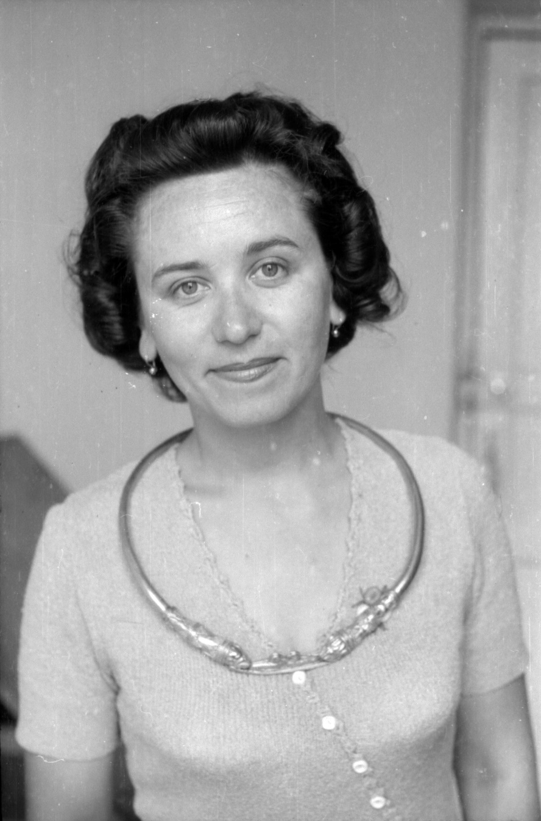
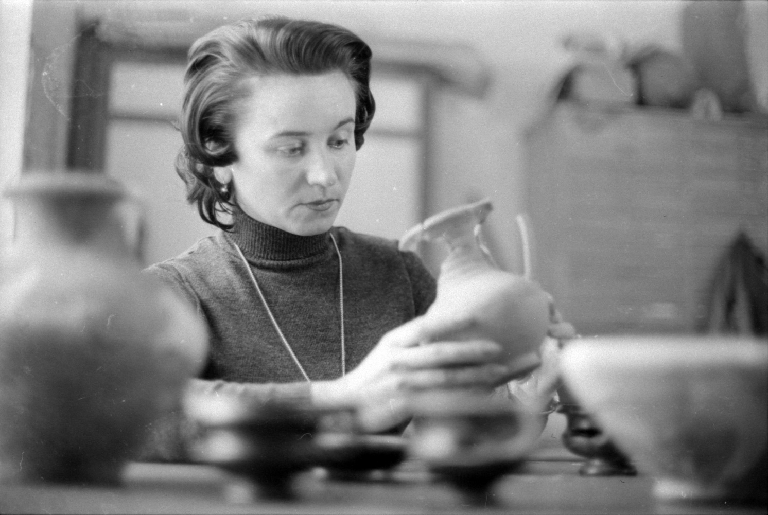
Natalia Serova, 1981

Slide 11
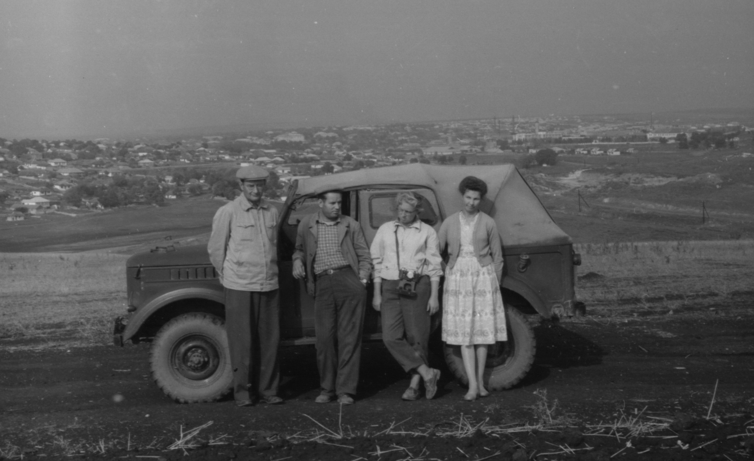
Galina Grigorieva
Varvarovka, 1961
Rașcov, 1971

Slide 12
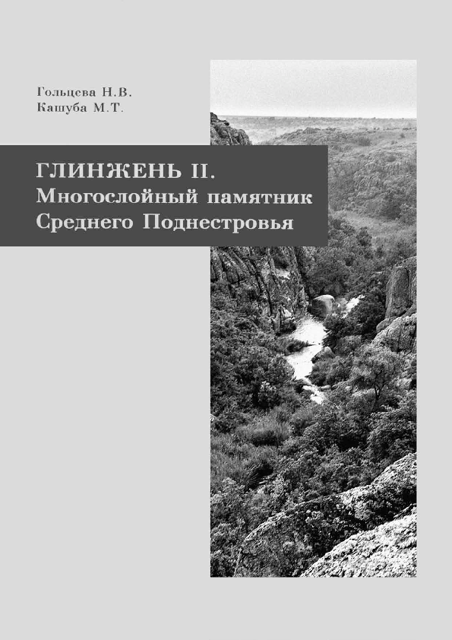
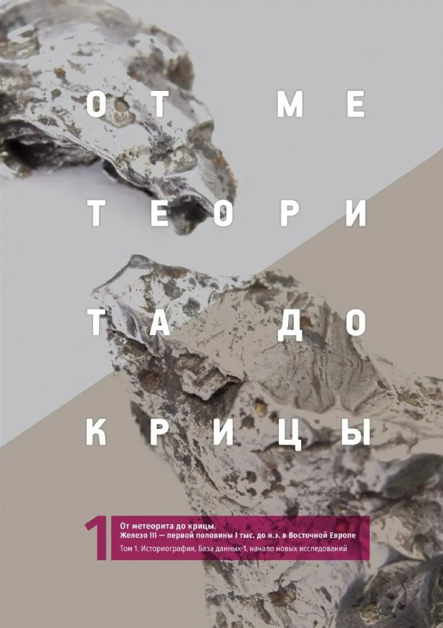
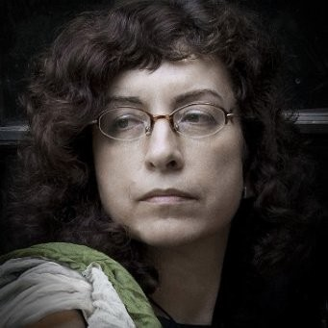
Maya Kashuba
Institute for History of the Material Culture Russian Academy of Sciences · Department of Archaeology of Caucasus and Central Asia

Slide 13
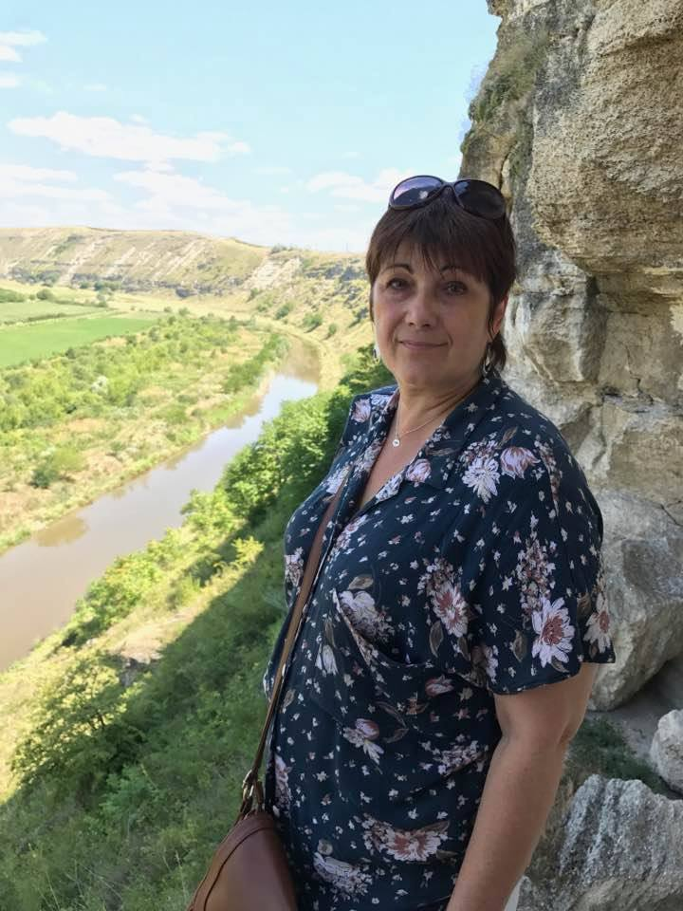
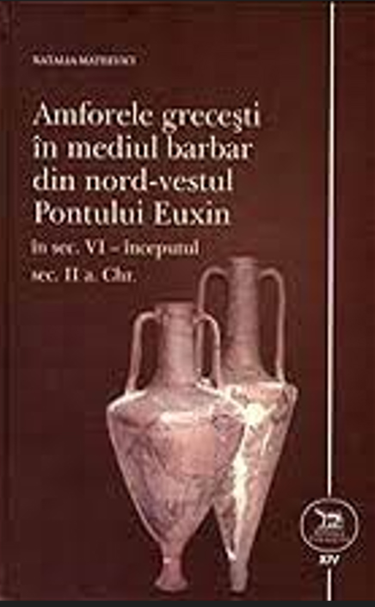
Natalia Mateevici

Slide 14
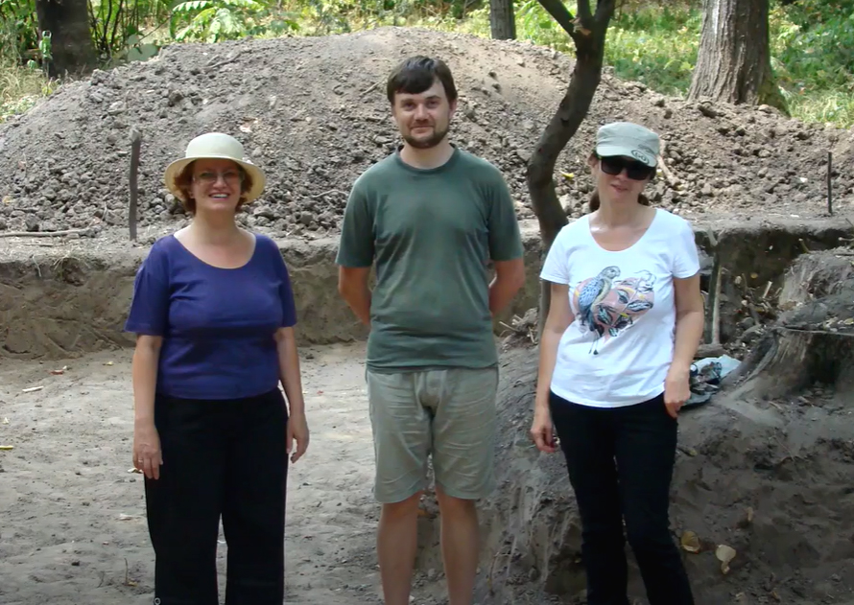
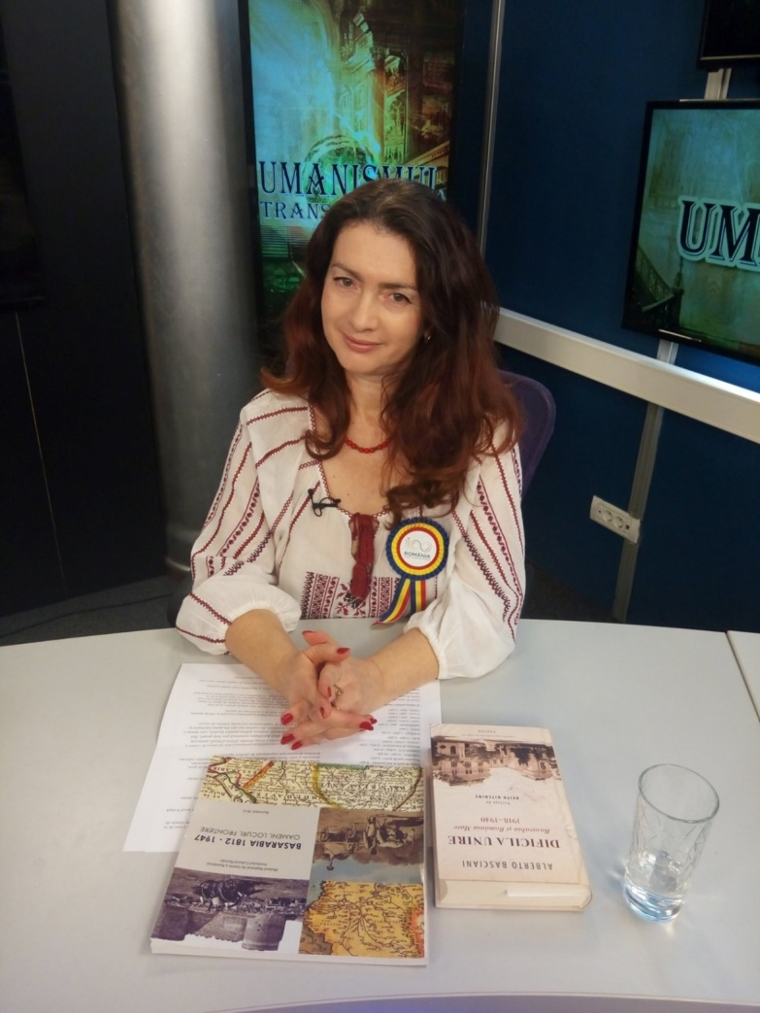
Rodica Ursu-Naniu

Slide 15
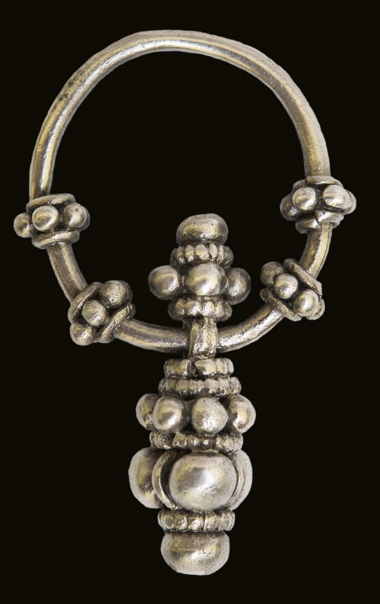
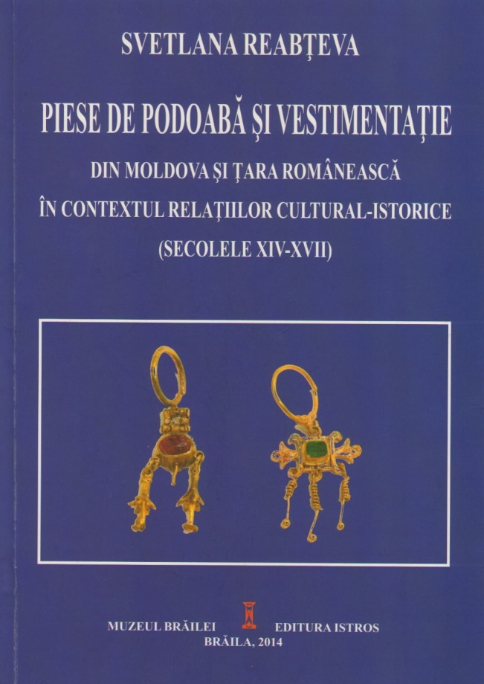
Svetlana Reabteva
7.12.1965 – 15.06.2019

Slide 16
Ecaterina Abîzov

Slide 17
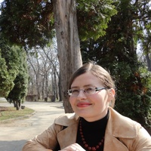
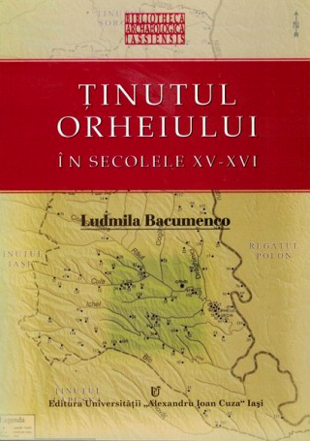
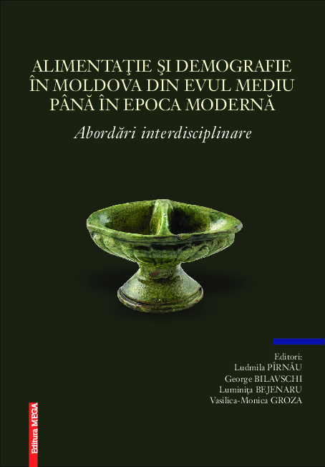
Ludmila Bacumenco-Pârnău

Slide 18
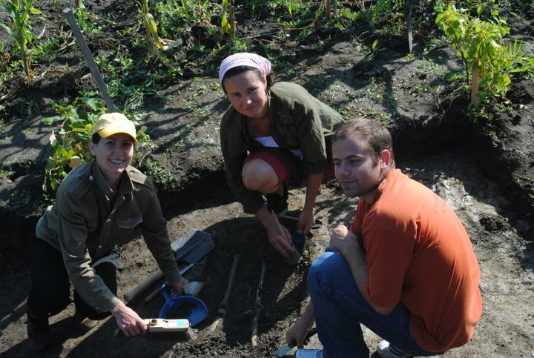
Larisa Ciobanu

Slide 19
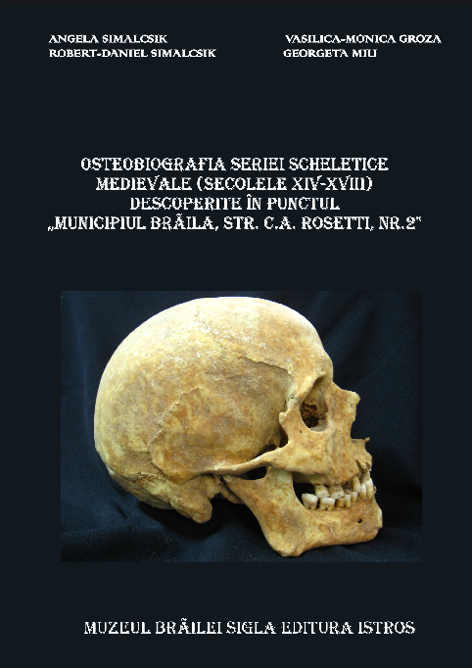
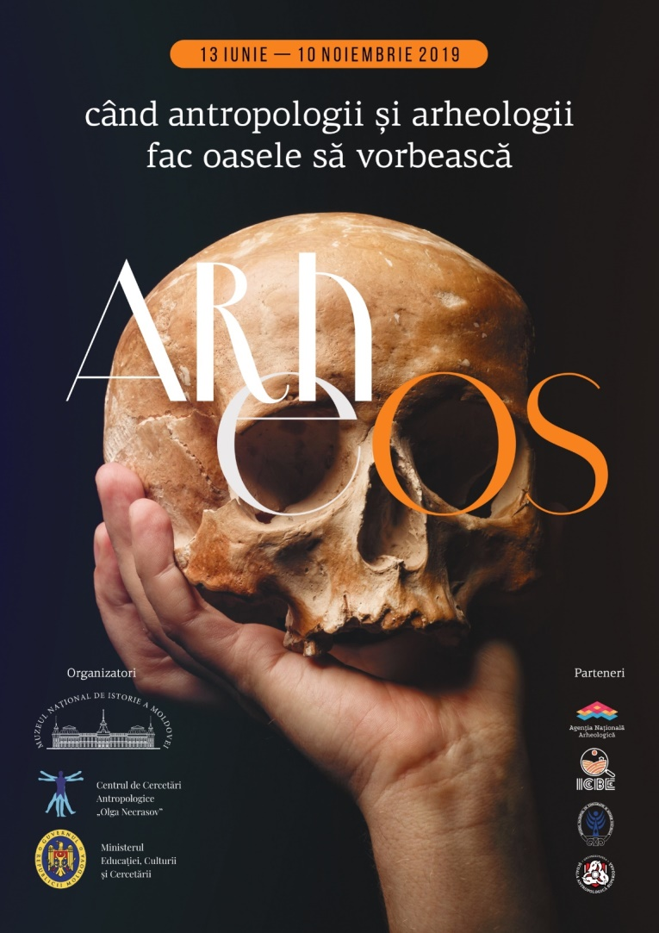
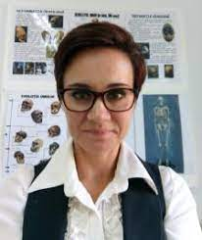
Angela Simalcsik

Slide 20
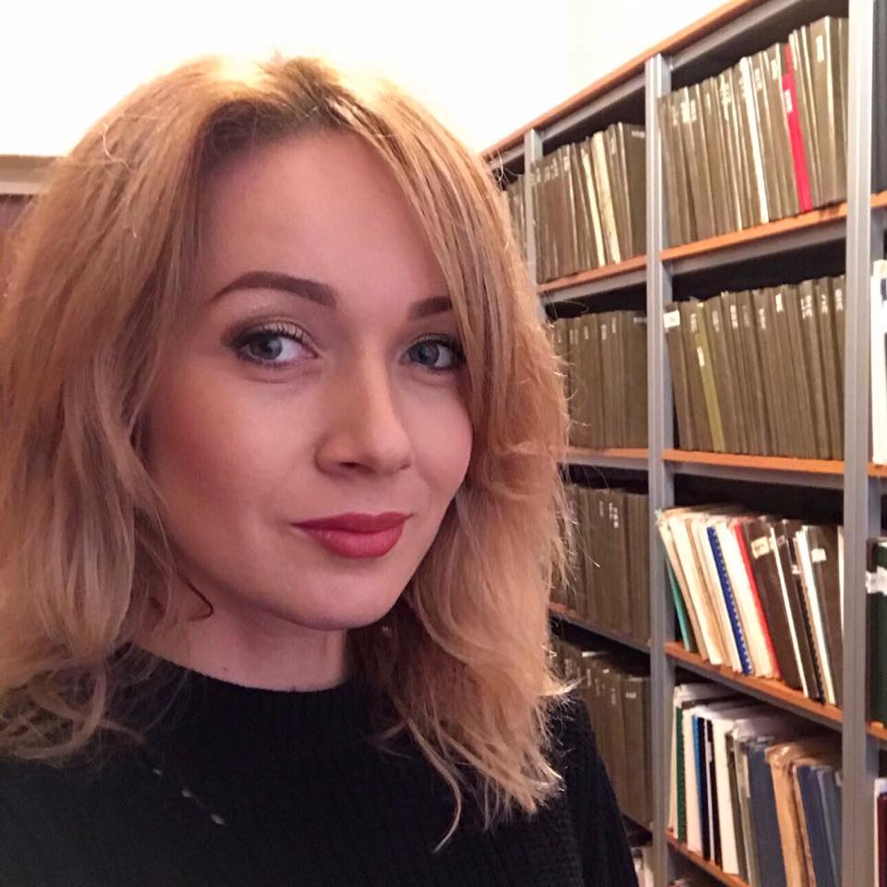
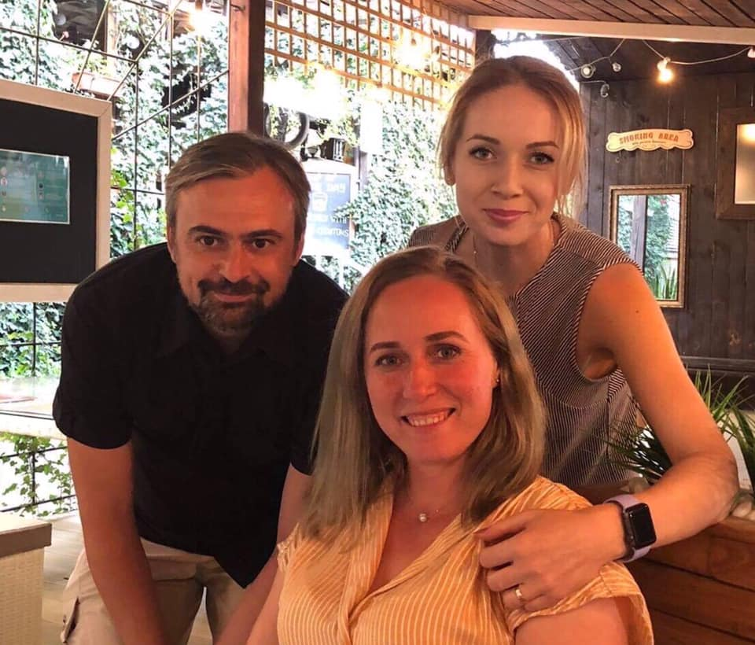
Mariana Sîrbu
Livia Sîrbu

Slide 21
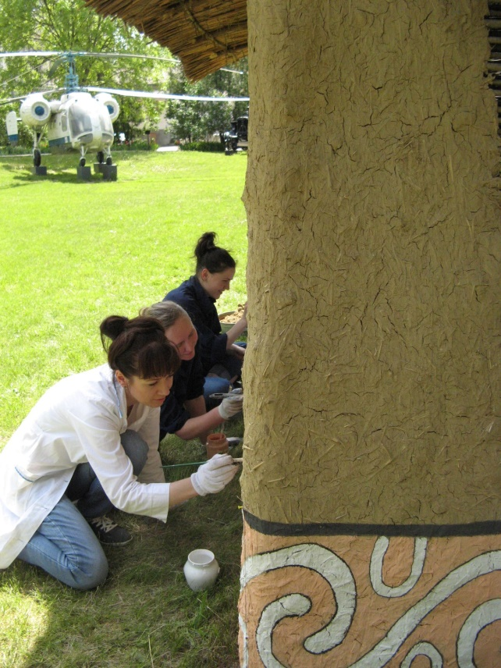
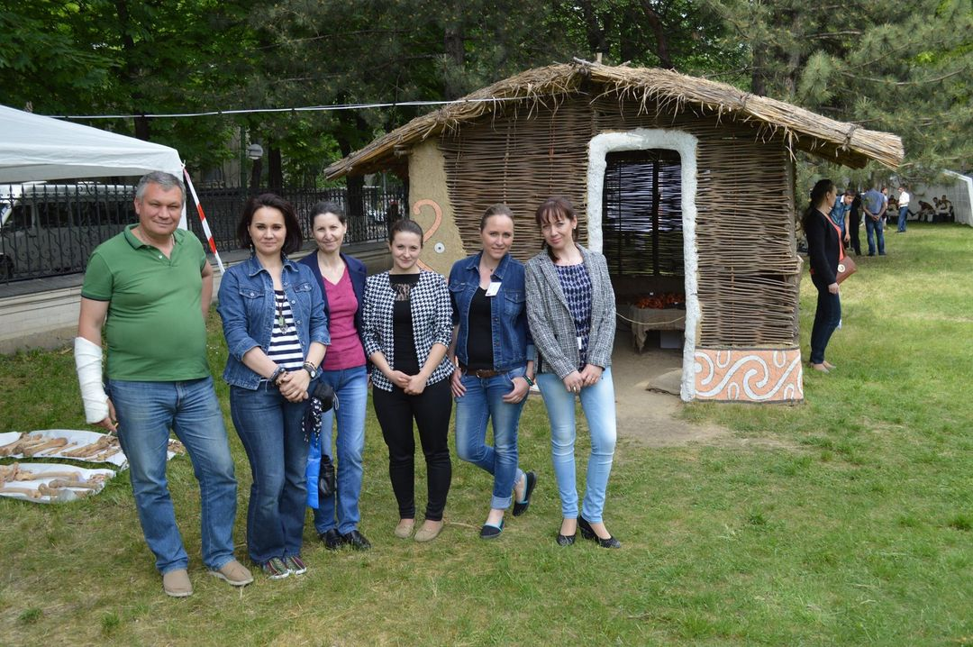
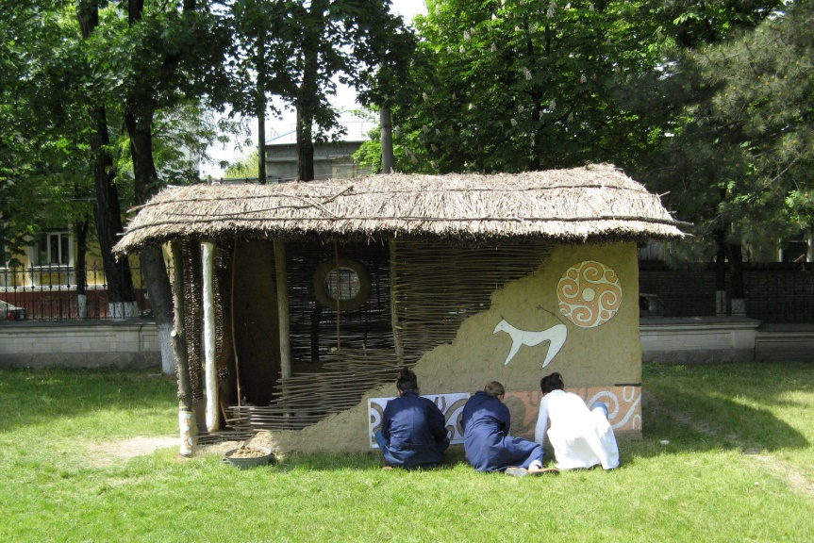

Slide 22
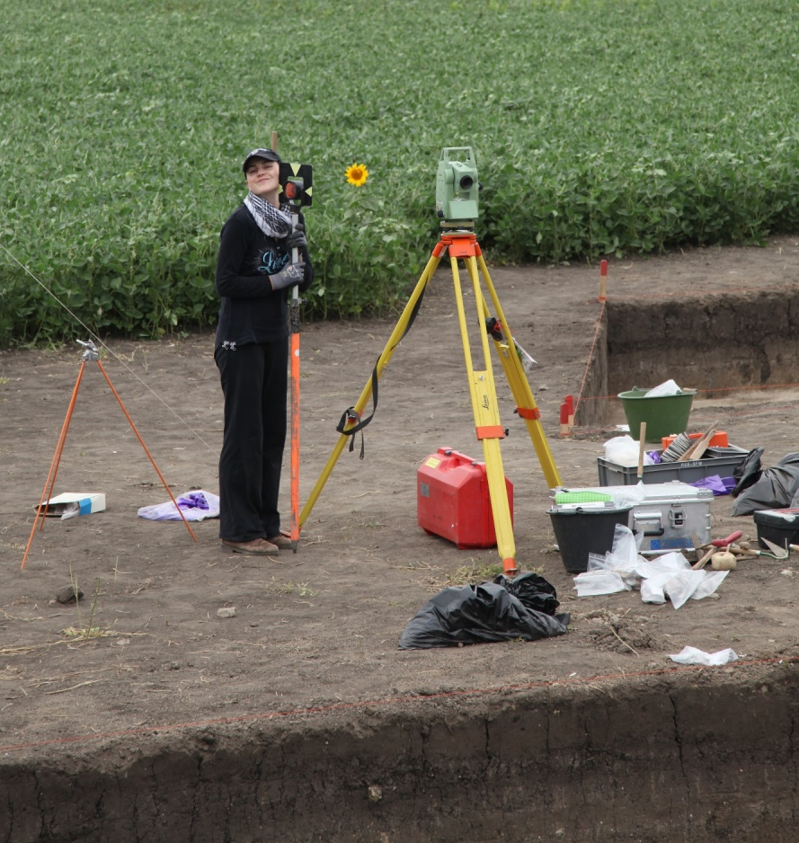
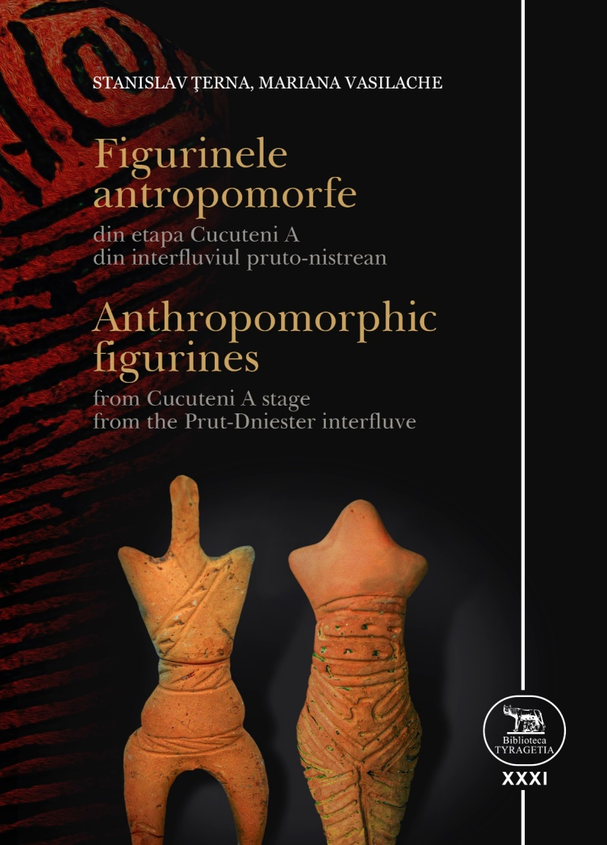
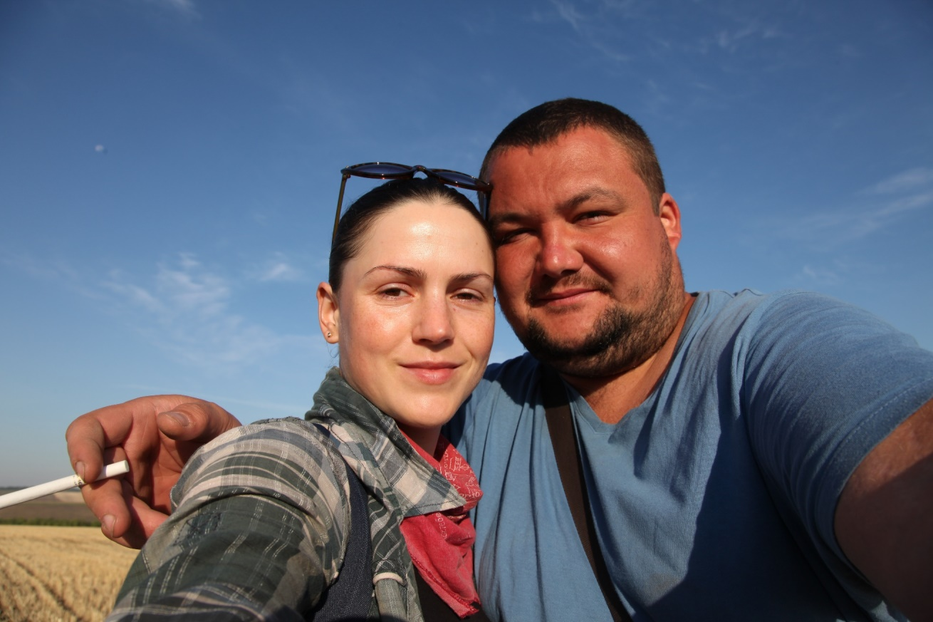
... In love with all this ”soft” world...

Slide 23
Thank you for your attention!

