Slide 1
THE CONTRIBUTION OF WOMEN TO THE ARCHAEOLOGY ON THE WEST COAST OF PONTOS EUXINUS
Diana Gergova

Slide 2
I chose this attractive topic with utmost pleasure when I was proposed because immediately to my mind came the images of so many women for whom I kept memories from the start of my career and with whom I collaborated and often passed by and visited their sites on my way to Ahtopol, as the last member of this female archaeological society. I did not know, however, how huge and inexhaustive this topic is.
Because, irrespective of the undisputed contributions of one of the most prominent Bulgarian archaeologists in the exploration of the Bulgarian Black Sea Coast, in Varna, Sozopol, Nesebar, Kaliakra, Kavarna, etc. such as the professors: Ivan Galabov, I. Venedikov, V. Velkov, I. Karayotov, M. Lazarov, A. Salkin, A. Minchev, D. Nedev. Etc .

Slide 3
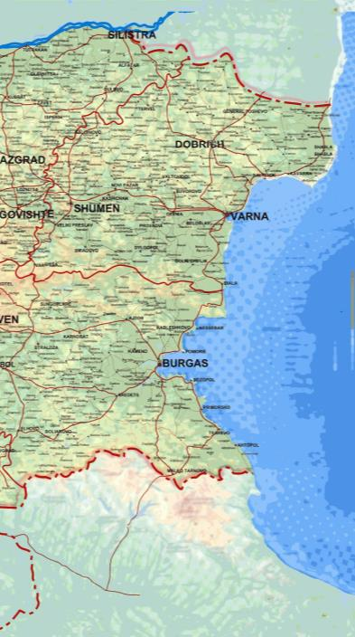
The conclusion, however, comes to show the exceptional contribution of the Bulgarian women archaeologists in the explorations along the Pont and the socialization of the archaeological excavations and findings, which predetermine the utterly new phase of our knowledge about the cultural history of the Western Pont.
Both the list of these women, who devoted their lives to the archaeological explorations, and the sites, to which they gave new life – cultural and public, are more than impressive.
We will move from north to south and paradoxically that travel will lead us from the revelation of the most ancient civilizations to the ones that came later.

Slide 4
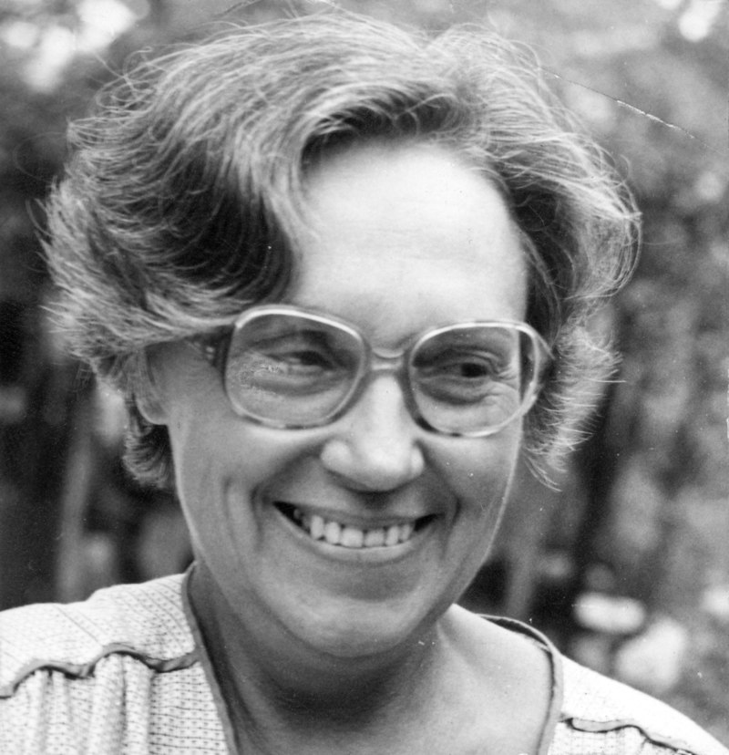
Let’s start with Durankulak and the explorer of this remarkable site - prof. Henrieta Todorova. The stout figure of that woman, looking at first glance cold and inaccessible and authoritarian, cannot be forgotten. She ordered, directed, but at the same time she had an amazing sense of humour, the spirit of a hooligan, while at home she knitted, which was for me in an incredible contrast with my idea of her.
We joked nobly with the several family names she had from her two marriages. Born in 1933, she left us at the age of 82 in 2015.
She was highly appraised on an international level as a corresponding member of the Bulgarian Academy of Sciences, a corresponding member of the German Archaeological Institute in Berlin, international member of the Leibniz Community Academy in Berlin. In 1964, she became a doctor of science in Nitra, in 1967, started work at the National Archaeological Institute with Museum at the Bulgarian Academy of Sciences. In 1978, she defended her habilitation project " The Chalcolithic Period in Bulgaria".
She is the founder of the Problematic Group of Interdisciplinary Research at the Archaeological Institute. She was the discoverer of many prehistoric cultures in North-Eastern Bulgaria and established the transitional period from the Eneolithic to the Bronze Age.
DURANKULAK AND HENRIETA TODOROVA

Slide 5
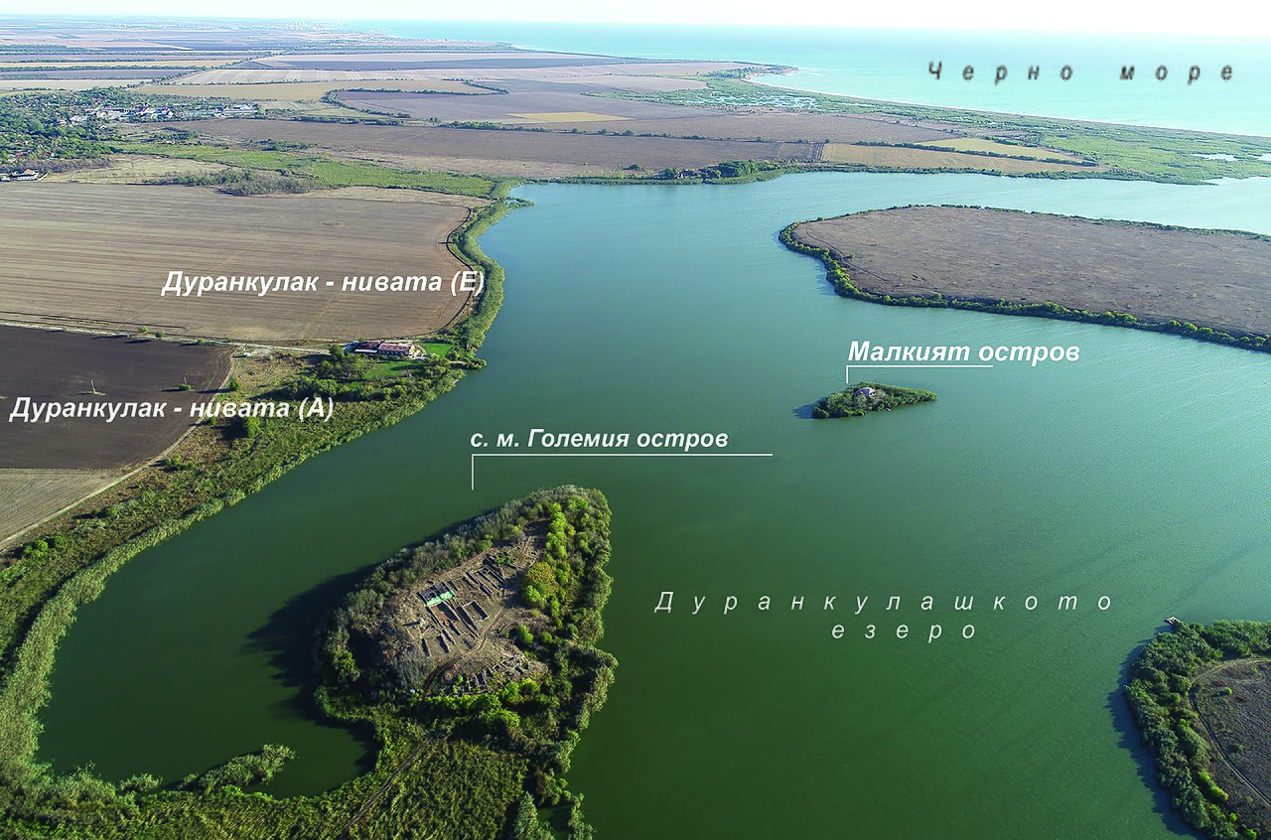
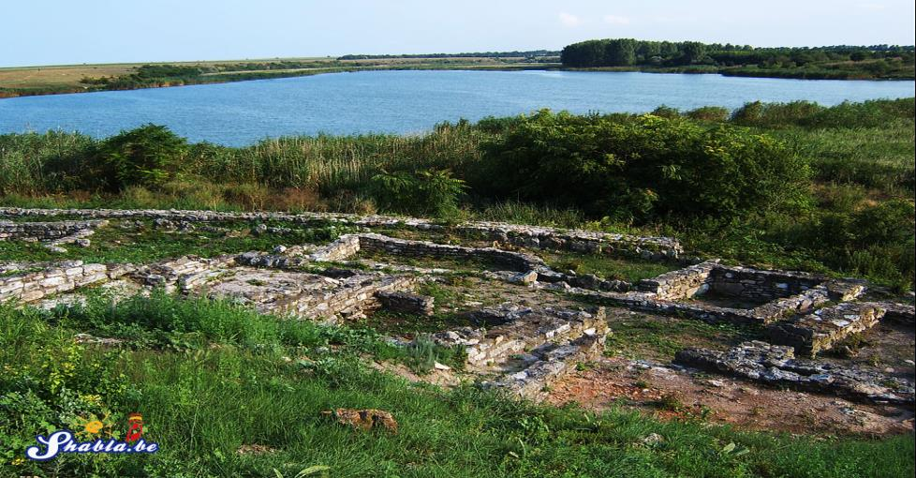
The exploration in the archaeological complex in Durankulak( 1974 – 2004), was her most important achievement. She revealed and explored settlements from the early and late Eneolithic / culture Hamanjia III–IV and culture Varna/, ritual pits and sacrificial pyre of proto - bronze and bronze age / cultures Black Water I and III/, fortified settlement of the late Bronze Age/culture Koslogeni/, ancient buildings with cave temple of the goddess Kibela and early medieval Bulgarian settlement, Prehistoric necropolis has over 1200 burials from the Neolithic, the Eneolithic and proto-bronze eras.

Slide 6
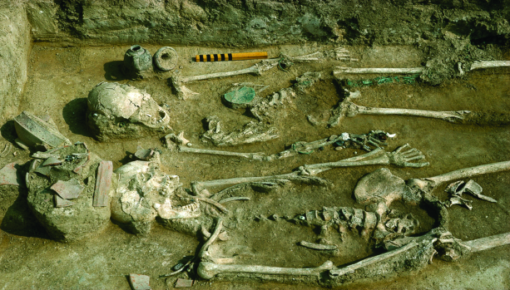
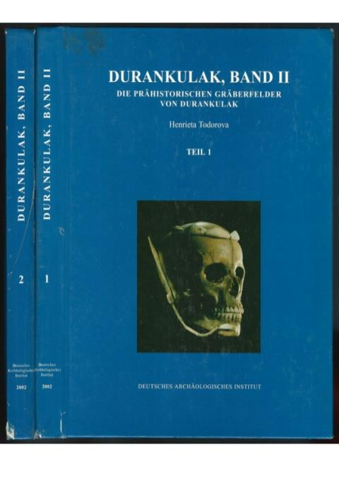
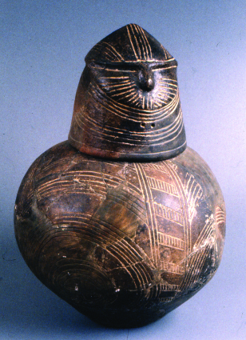
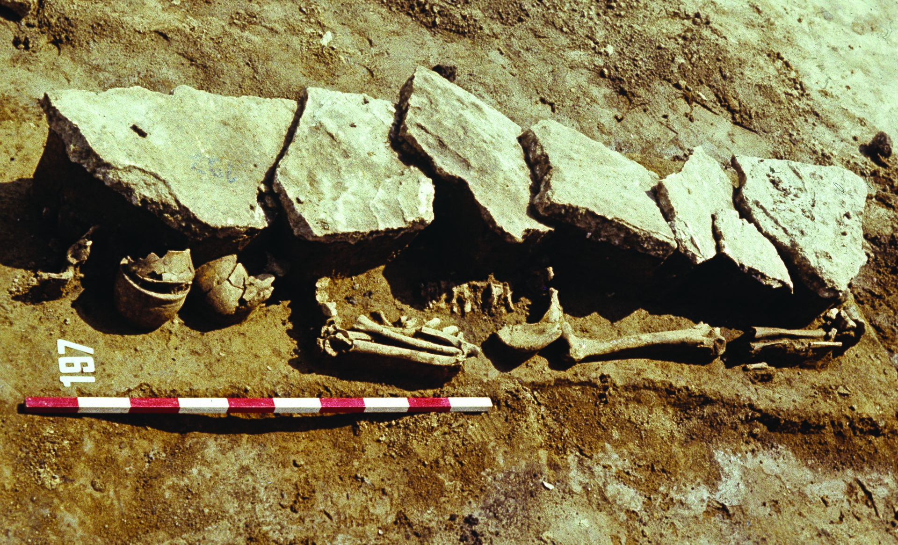
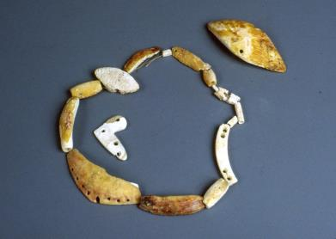
H.Todorova issued the scientific works of several volumes Durankulak - published by the German Archaeological Institute.

Slide 7
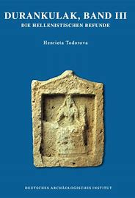
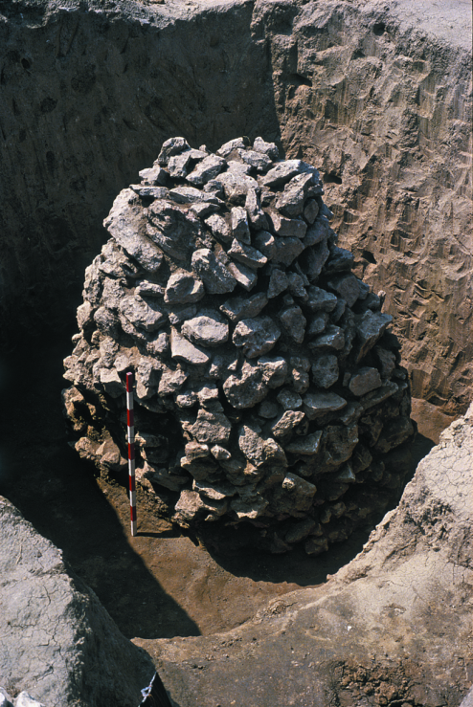
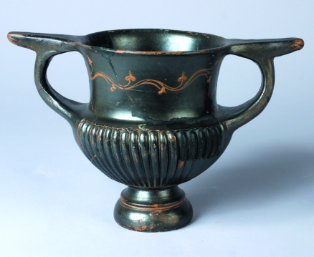
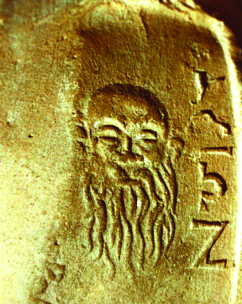
THE HELLENISTIC PERIOD

Slide 8
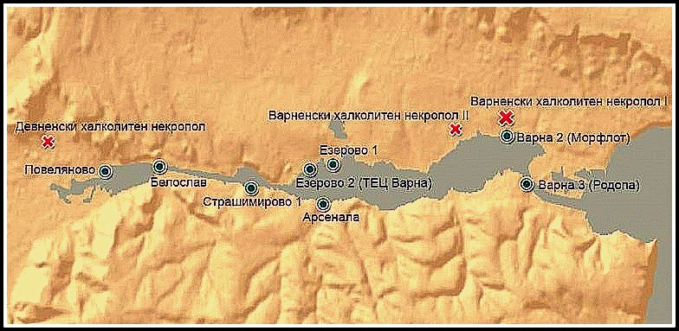
KAVARNA, VARNA AND GORANA TONCHEVA.
Moving south, we must highlight the contribution of another extremely courageous woman - Goranka Toncheva. She worked in the Archaeological Museum in Varna, and later in the Institute of Thracology at the Bulgarian Academy of Sciences.
Goranka Tocnheva. made significant contributions in the field of prehistory in the localization and exploration of series of settlement on the earth and under the waters of the Varna and Beloslav Lakes, related to the areal of Varna Civilization. She made them within rescue excavations related to new constructions and as a systematic scientific interest.

Slide 9
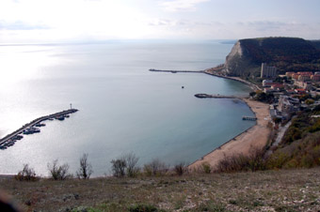
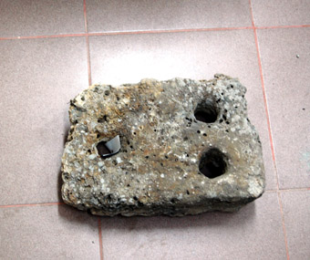
CHIRAKMAN AND THE UNDERWATER INVESTIGATIONS
G. Toncheva made also one of the earliest underwater archaeological explorations in our country near Cape Chirakman in 1961, when she localized two queys and marked the contours of the sunken part of Bizone during the earthquake in I century BC, also coming across a brick wall with mortar. In 1969 and 1971, she found an underwater breakwater and a complex of 26 caves – warehouses for the storage of crops, from V – VI century.

Slide 10
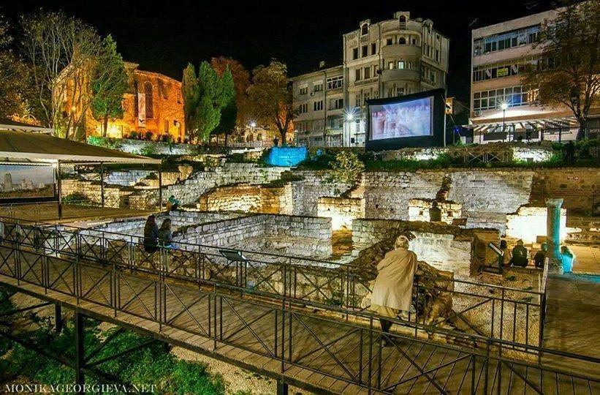
THE SOUTHERN ROMAN BATHS
G.Toncheva investigated in 1961-62 the architectural complex located right over the seashore, on two terraces : the lower part - probably the changing room, a stone staircase leading into a wide backyard (palestra), and from there to the other premises – tepidarium, caldarium, frigidarium, etc. Next to the thermae, there was a bathtub found, which was used for glass clarification, dating back from V-VI c.
Thе excavations revealed many valuable artifacts - ornaments, clay lamps, amphoras, more than 450 bronze coins, votive reliefs of the Thracian god – rider and the Thracian goddess Bendis, plaques, depicting a sitting woman and Eros, vessels of praise - an evidence for the function as sanctuary of the building in the north-eastern part of the site of the Thracian god – rider and the Thracian goddess Bendis.

Slide 11
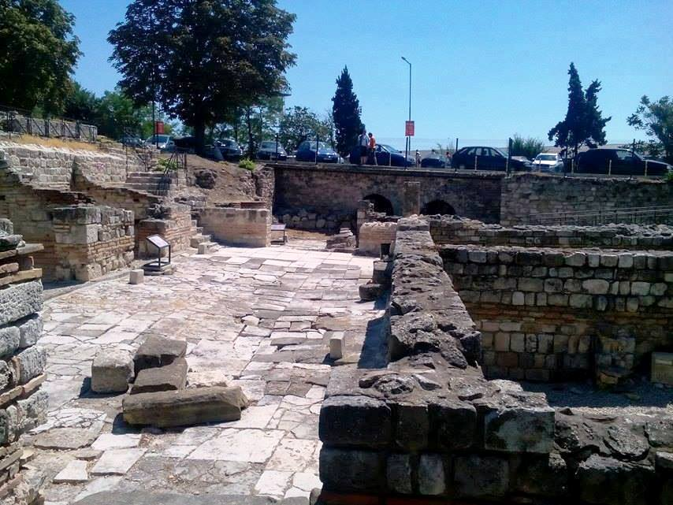
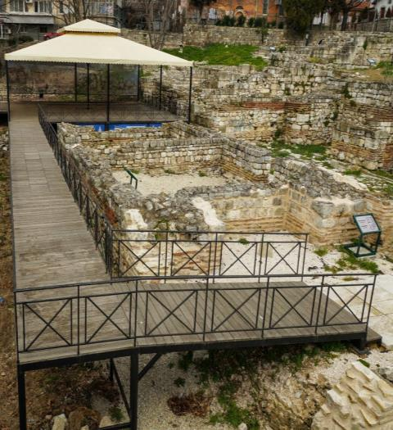
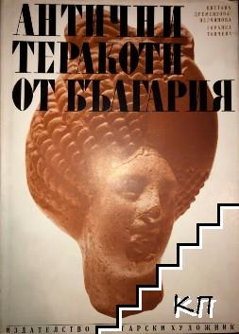
The socialized baths are place for different cultural initiatives

Slide 12
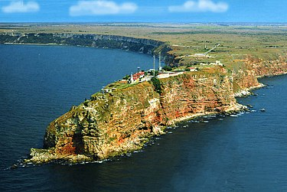
KALIAKRA AND ITS WOMEN EXPLORERS
The exceptionally beautiful Kaliakra Cape is a site of long-term archaeological exploration in the 60-70’s of 20 c. , where together with G. Dzhingov, explorations were led by Ana Balshtanska and Maria Yosifova. In that first phase of the explorations, they found the remains of the first Thracian fortified settlement of IV BC - Thirisis, known from the story of Strabon, as the seat of the famous commander of Alexander the Great, Lysimachusq the fortification systems from the Roman Age (I-III AD) and from V-VI AD, when the settlement had the name Acre.
In Х AD it was called Tatrasida and Tetrasiada.
In the second half of ХIV AD the Bulgarian boyars Balik and Dobrotitsa, made the fortress the capital of their independent kingdom, the Despotate of Dobruja or Principality of Karvuna, which coined its own coins.
In 1393-1394, it fell under Ottoman authority.

Slide 13
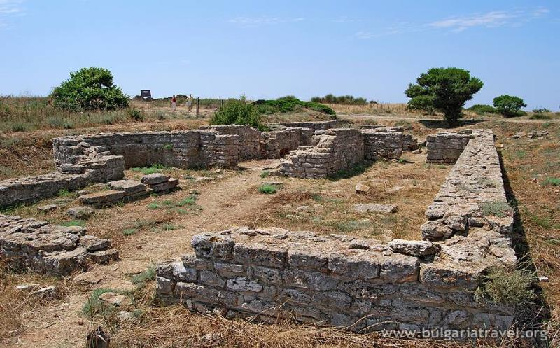
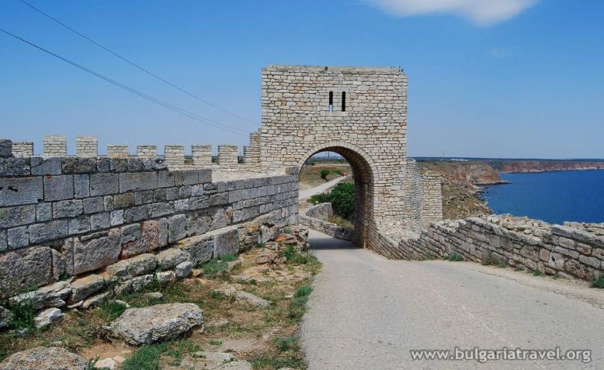
THE RESTARTED INVESTIGATIONS OF BONI PETRUNOVA
Remains of the fortress walls, of the main medieval despot residency, numerous Christian necropolises from different ages were found. The explorations, restarted in 2004 by Dr. Boni Petrunova, found out traces of Proto Bulgarian attendance - a huge praise pit with traces from magical rituals, a huge apse from a church, related to the rich medieval necropolis, as well as a Thracian sanctuary with carved structures, probably devoted to Zalmoxis and related to the Hellenistic Thirisis.

Slide 14
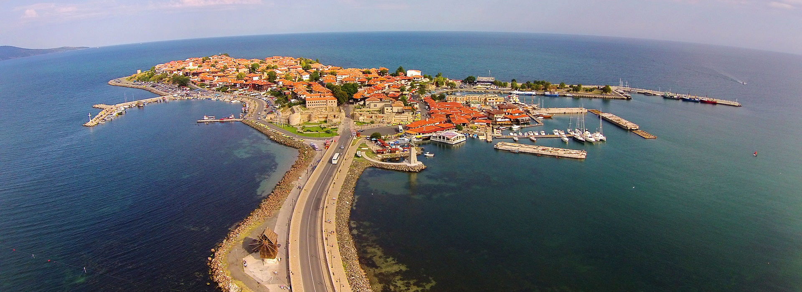
NESEBAR AND THE WOMEN WHO MADE IT A TOWN-MUSEUM AND UNESCO WORLD HERITAGE SITE

Slide 15
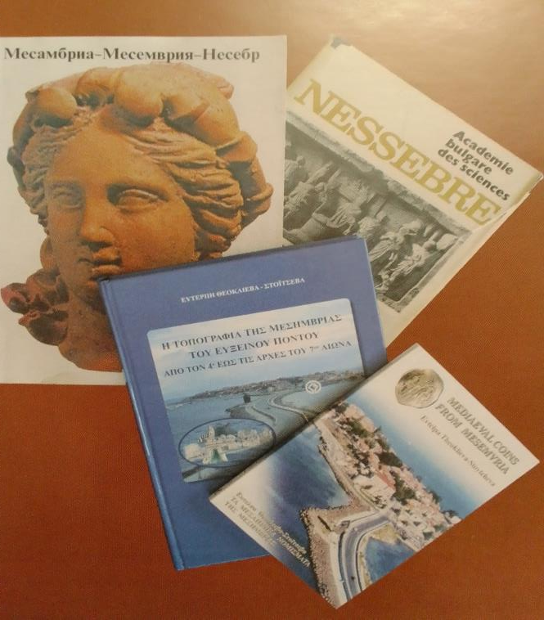
Nesebar, the ancient Thracian settlement, became the Greek colony Mesambria about 510 BC. 5 chronological periods of urbanization were distinguished, starting with the earliest fortress wall dating from 8 BC, another one encompassing the city dating from 4 BC , and some newer ones from the middle of V AD in opus mixtum. There is data about temples of Zeus and the protector of the city - Apollo, of Asclepius, Hecate, Isis, Dionisius, the Thracian Rider (Heros), a theatre and large thermae.
It was annexed in 812 AD to the Bulgarian state and till the end of XIV c. during the wars between the Bulgarians and the Byzance, it often passed from one’s hands into the other’s.
The Christian monuments in Nesebar are impressive.
Its architecture from the National Revival is also very illustrative.
Nesebar was explored by many prominent male archaeologists – such as the professors Ivan Galabov, I. Venedikov, I. Velkov, I. Karayotov. Today, however, when we hold this meeting exactly here, we must point out that the town-museum owes its fame to three women.

Slide 16
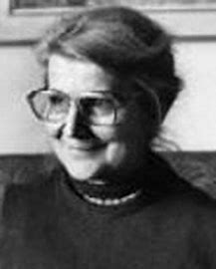
LYUBA OGNENOVA /1922 - 2012/
Born in a courageous family in Ohrid, L. Ognenova finished the French primary school in Bitola, classical high school in Tirana. In 1946 she graduated from St. Kliment Ohirdski University of Sofia with the specialty history and classical philology. She started work in the Museum in Shumen in 1948 and the same year she was already in the Ancient history department of the Archaeological Museum in Sofia.
From 1948 till 1957 she was a member of the team, who explored the Thracian city of Seuthopolis and was one of the first explorers who identified Babyashka chuka in 1957 as a sanctuary of Zeus and Hera.
The sensational encoding of the so-called „Illyrian text“ on a ring from Koman, North Albania, which she presented at an international forum, was the reason for Ognenova to be invited for specialization in 1959 – 1960 in the French School in Athens.

Slide 17
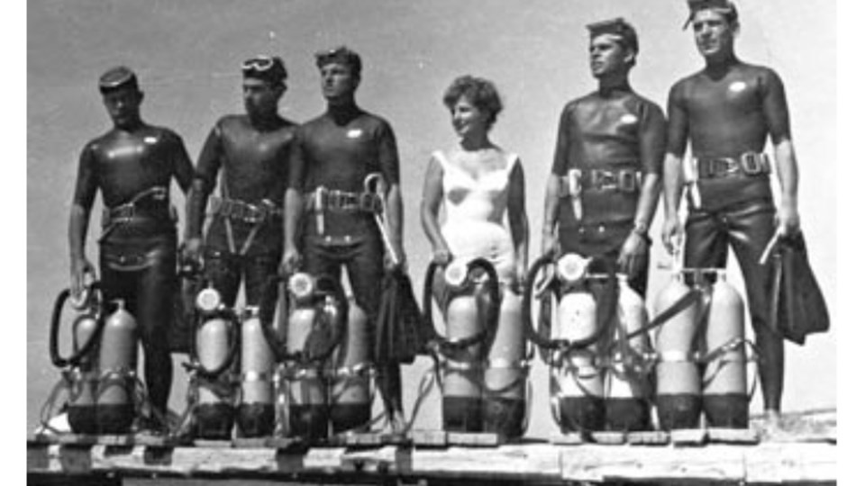
Many of her works investigate the Greek colonies along the Bulgarian Black Sea coast. From 1957 till 1983 she was the assistant of prof. V. Velkov of the excavations in Nessebar and contributed a lot in the exploration of the old town and its monuments.
In 1961, L.Ognenova became the first female diver – underwater archaeologist, setting the start of the exploration of the underwater heritage of the ancient town and also one of the women pioneers in the world underwater archaeology.
The artefacts discovered by Lyuba Ognenova contributed to the declaration of Nessebar as a UNESCO world heritage
She was awarded the title of honorary citizen of Nesebar,author of more than 100 science articles, a member of the French School in Athens, a corresponding member of the Archaeological Institute in the Federal Republic of Germany and of the International epigraphic organization.

Slide 18
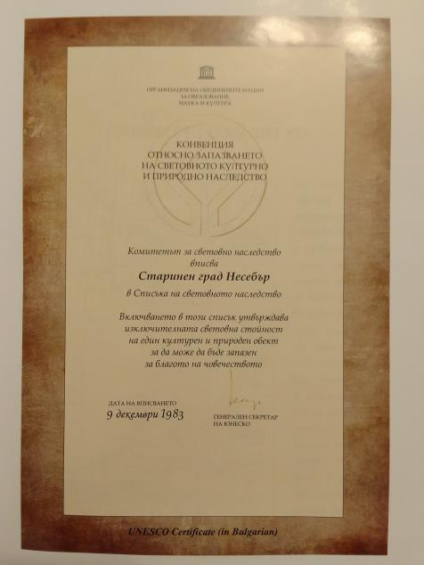
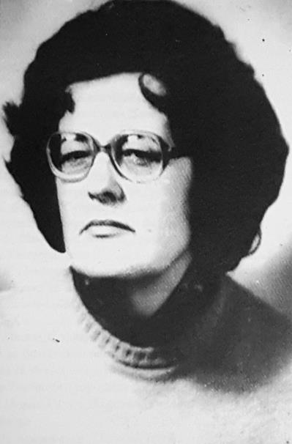
ZHANA CHIMBULEVA. THE WOMAN WHO DISCOVERED NESEBAR FOR THE WORLD.
Zhana Chimbuleva graduated from Sofia University with the specialty History and Archaeology.
She was the founder of the museum work in the town - of the Ethnographic Museum, of a smaller and earlier archaeological museum and finally of the modern archaeological museum .
She saved Nesebar’s icons.
‘My dream was to make the town international’, Zhana Chimbuleva said.
The reference number of the documentation submitted at UNESCO was 217 of 29.04.1982. The town was declared World Heritage on 09.12. 1983.

Slide 19
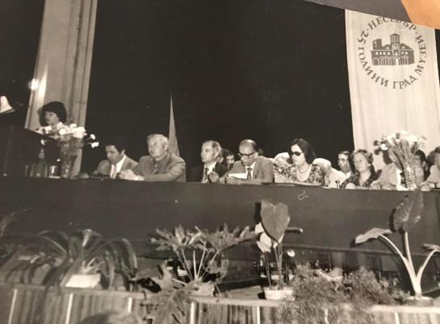
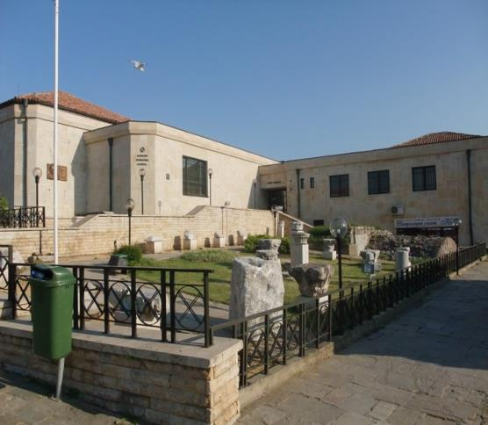
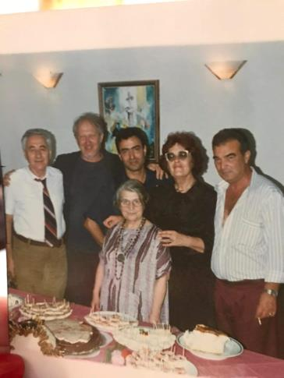
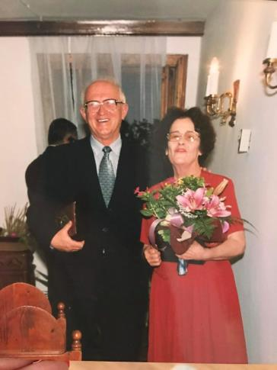
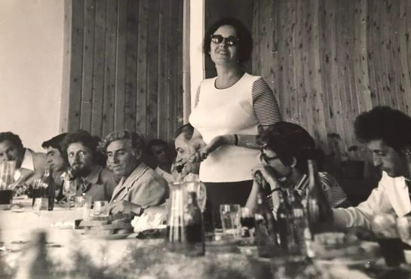
Her family was the museum and the town. She was explorer of the architectural monuments of the ancient Nessebar, deserving cultural figure, honorary citizen of Nessebar, holder of numerous state awards, organizer of international conferences, author of numerous articles and books.

Slide 20
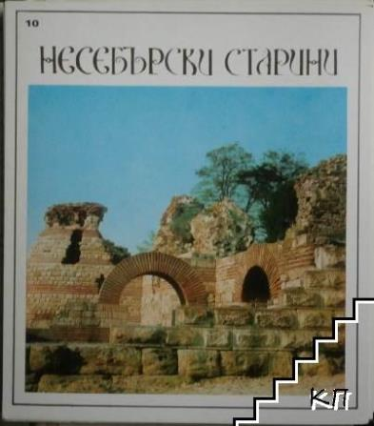
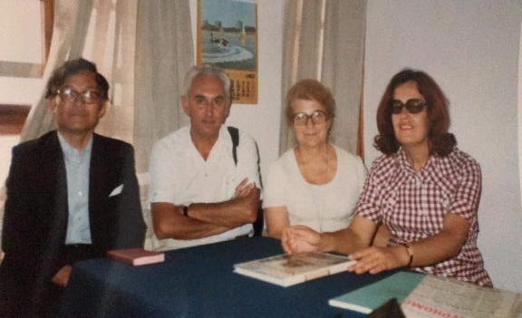
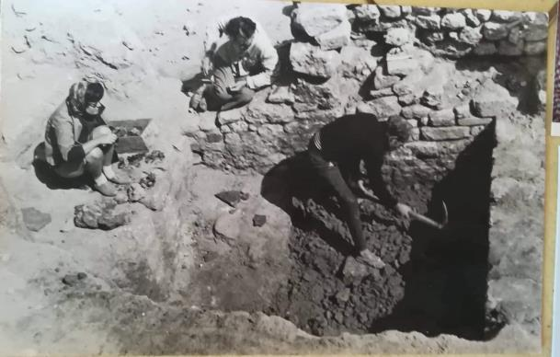
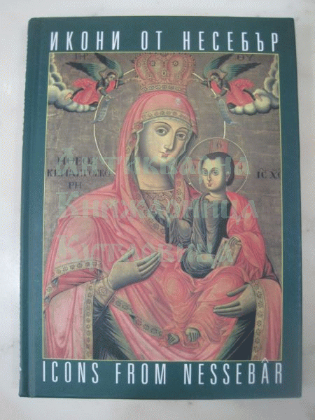
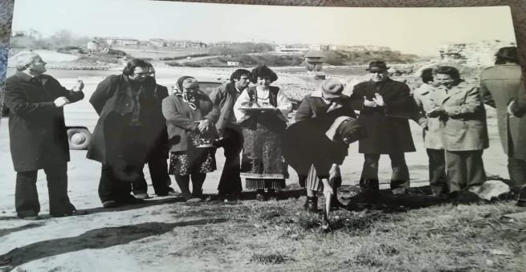
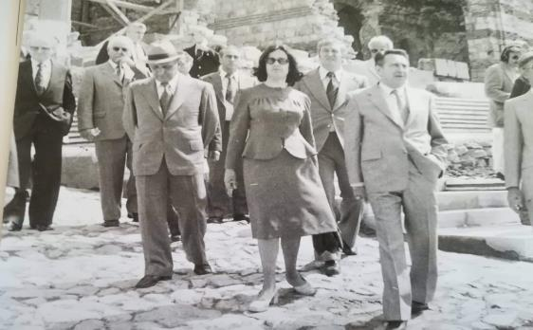
CONTRIBUTIONS AND .....

Slide 21
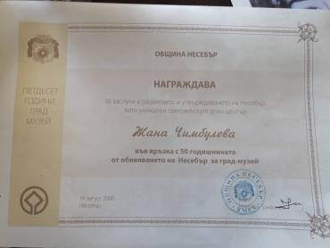
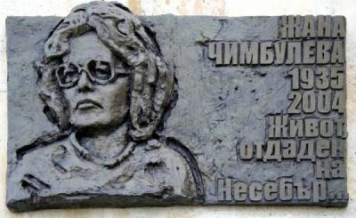
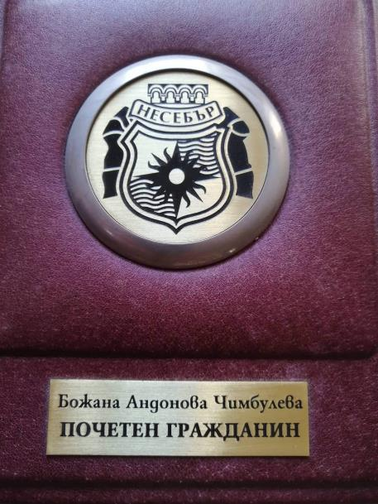
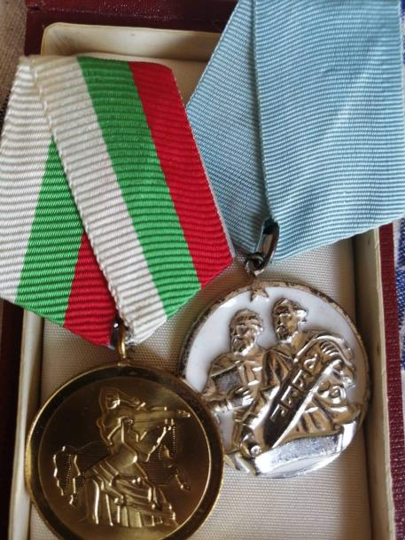
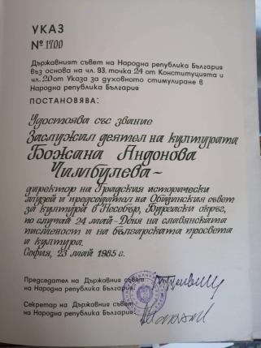
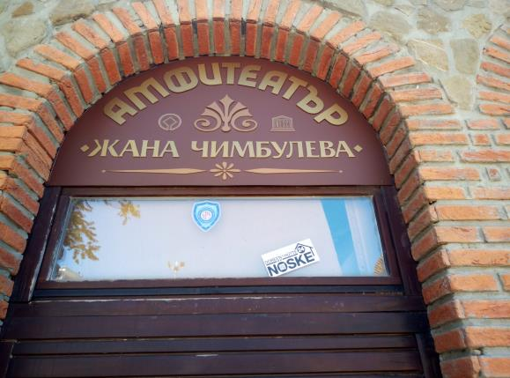
.....
... AND REWARDS

Slide 22
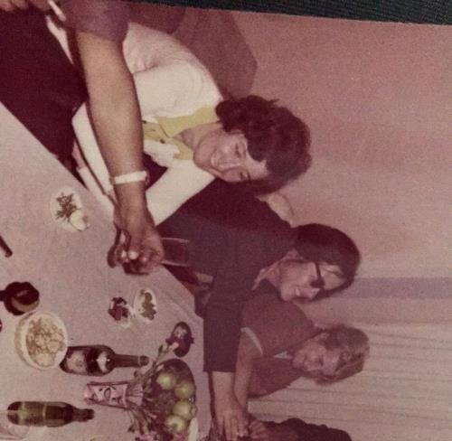
EVTELPA STOYCHEVA. THE ONE WHO CONTINUED THE CAUSE.
I met Evtelpa because of a Thracian fibula she found during explorations of Strandzha.
Born in Nesebar in 1950, Evtelpa Stoycheva was a direct participant in the work of the archaeological team and independent explorer between 1975 and 1996. Now she is the active factor in the Ancient Nesebar Department where she managed its numismatic section from 1982 till 1996. She graduated the Sofia University with specialty history with archaeology and Greek philology and demonstrated during her university years her interest in the Medieval problematics. She specialized Balkan Cultures in Thessaloniki, Greek language and culture in the Athens University where she defended her PhD thesis on Topography of the Early Medieval Nessebar (1999 – 2004).
She took part and ran the archaeological explorations of the town fortress walls, in underwater explorations of Nessebar peninsula (1976 - 1983), of the ancient temple in the new part of the town, of the building from the Late Antiquity (the Thermae), of the three-nave basilica, of drills and rescue explorations of archaeological sites on the peninsula

Slide 23
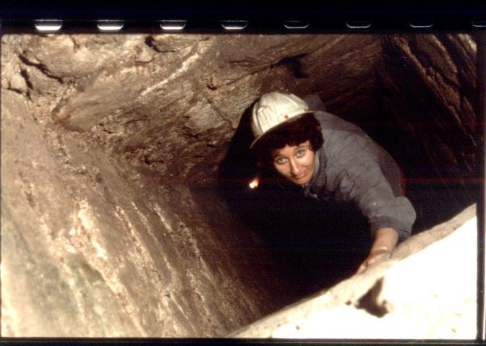
.A particular contribution is the studies of Eutelpa of the Water Supply System of late antiquity Mesemvria - the first underground archaeological studies in Bulgaria "Underground Corridors".
She explored also Old Metropolitan Archdiocese, the St. Mary Eleusis basilica,, St. Peter Monastery ,in the village of Sveti Vlas, etc. .Registered monuments in the Eastern Balkan Mountains and carried out cave explorations in the Strandzha Mountains.
She took part in series of national and international conferences and symposia, as well as in international programs such as “Historical and Archaeological Atlas of Kolchis” in cooperation with the Archaeological Institute of the Island of Crete, the Athens Cultural Centre and the Institute of Classical and Byzantine Explorations at the University of Tbilisi, Georgia) in 2001 - 2003 and in INTERREG III-A / PHARE CBC “Elaboration of a program for the exploration of the traditional culture in the border areas between Bulgaria and Greece (2000-2006)” (2000-2002, first phase).

Slide 24
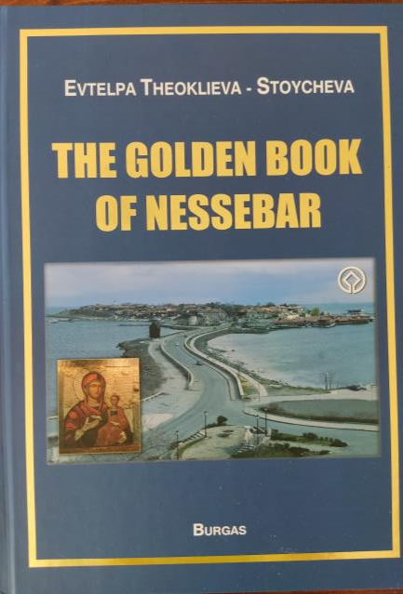
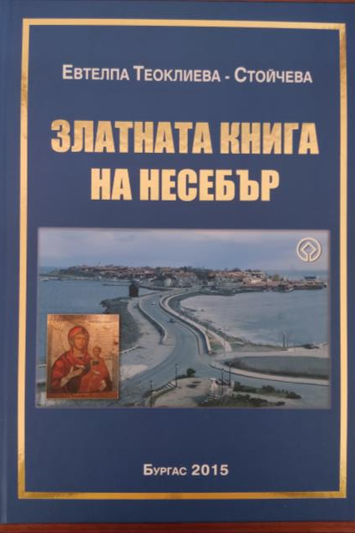
THE GOLDEN BOOK OF NESSEBAR
Evtelpa is the author of several publications, but her absolute contribution to her town is the Golden Book of Nessebar published in Bulgarian and English, which perpetuated forever disappearing, unfortunately unpreserved remains of the most ancient relics of the town.

Slide 26
TO THE SOUTH TO BURGAS. TSONYA DRAZHEVA
Tzoniya Drazheva /1954 - 2013/ graduated the Sofia University, was research associate, curator and long-term director of the Regional historical museum in Burgas.
In 1999 – 2000 was the director of the
Centre for Museums, Galleries and Art
at the Ministry of Culture.

Slide 27
During her long career along the shores of the Pont, she explored the ancient necropolis in Pobeda, Burgas, the medieval fortress of Goloe, Lozarevo, worked in Deultum, studied the fortress walls and the episcopal centre St. Nicolas Monastery, the ovens for sgraffito ceramics in Sozopol, St. Paraskevi church at the Ropotamo River, part of the fortress wall of Ahtopol, the fortresses on Phoros peninsula near Burgas , St. John the Baptist Monastery on St Ivan island near Sozopol, etc.

Slide 28
The socialization of the megalith Thracian sanctuary of Begliktash near Primorsko, one of the largest prehistoric megalith sanctuaries on the territory of Bulgaria, whose central part occupies an area of about 8 decares, should have been a great satisfaction for Tsonya. It was amazingly exposed and is being intensively visited, which is the biggest reward and honour for every explorer – archaeologist.

Slide 29
DEULTUM - DEBELT NATIONAL ARCHAEOLOGICAL RESERVE.
KRASIMIRA KOSTOVA
The colony Flavia Pacis Deultensium was found during the years of Emperor Vespasian in the 70’s of the 1st century near the already existing Thracian settlement of Develt, near Mandrenkso Lake, in an area densely occupied with sites from the Late Bronze Age till the Late Middle Ages.
The large-scale excavations started as rescue operations during the 80’s under the management of S. Damyanov and P. Balabanov and continued by L. Vagalinski and H. Preshlenov.
A medieval fortress and a church with customs building were discovered and materials dated from 4-2 BC in the Ercesia defence facility from the Early Middle Ages confirmed the existence of a Thracian city from the Classical and Early Hellenistic Age.
But the main responsibilities for the lasting excavations, the preservation of the ruins, the creation of the museum and the efforts to transform the site to an important tourist destination are due to the efforts of the doyen Krasimira Kostova, now the director of the whole complex.

Slide 30
Кr.Kostova explores a bathroom with 4 prefurniums, as well as the layers from 6 – 7 AD - a period, which is not so often met at the archaeological sites and which will provide new data about this interesting period.

Slide 31
The site is the only one in the country marked as "European Cultural Heritage."

Slide 32
THE MUSEUM
THE MUSEUM
The museum keeps exceptional discoveries and artifacts from then ancient necropolis and the explorations of the town.

Slide 33
APOLONIA PONTICA. MARIA TSANEVA. HRISTINA ANGUELOVA.
KRASTINA PANAYOTOVA
Relics show the start of populating the area and origin of settlements back to 3 to 4 thousand years before Christ. On the place of an ancient Thracian settlement, in 610 BC, Greeks from Miletus found the colony of Apolonia Pontica and it was among the first city centers on the Balkans, where monetary exchange was used back in VII-VI century BC - arrows (coins), later replaced with real silver coins minted from the start of VI century BC.
In 4 century AD it was named Sozopolis.
It was annexed to the territory of the Bulgarian state in 812.

Slide 34
In the distant years of my youth, in the 70’s of the 20th century, when Strandzha-Sakar programe was initiated, Sozopol did not have today’s wonderful Archaeological Museum, where now you are able to see the amazing discoveries.
The curator then was Maria Tsaneva. She left us too early and it is difficult to find public data about Maria now, but she was one of the figures in many of the photos , together with Zhana Chimbuleva and Evtelpa Stoycheva. Because she was the lively person, the driving force in the explorations of Apolonia and Pontos Euxinos also with her support for all expeditions around Strandzha.
Another name that those involved in underwater archaeology will probably talk about is that of Hristina Angelova, whose life was inextricably linked to the Center for Underwater Archaeology established in Sozopol.

Slide 35
KRASTINA PANAYOTOVA
Here, as it was in Nessebar, except the French archaeologists, at the start of the 20th century, the pioneers in the explorations in the period 1946 – 1949 were men: Teofil Ivanov, Ivan Venedikov, Todor Gerasimov, Mihail Lazarov, and the first underwater expedition was led by Ivan Galabov. Here, as it was in Nesebar, we owe the big archaeological discoveries mostly to the lasting and methodical efforts of a woman - Dr Krastina Panayotova from the National Archaeological Institute with Museum at the Bulgarian Academy of Sciences.

Slide 36
Krasina Panayotova/1958/, specialized at the Centre Camille Jullian, CNRS, Aix-en-Provence and in École française d'Athénes. The dissertation "Funeral rites and burial facilities in the Greek colonies along the Bulgarian Black Sea coast (6th – 11th century BC) n.e.)' prepared under the scientific advises of Luba Ognenova.
She is Head of Section on Ancient Archaeology of NIAM.
Since 2002 is Head of the Bulgarian-French Research Projects "Apollonia Pontica - Polis and People" and "Apollonia Pontica – Necropolis and Territory".
Curator of exhibitions dedicated to the investigations in Sozopol and to the French Bulgarian collaboration.
Organizer of the International Scientific Conferences "Apollonia Pontyska" – Sozopol, 25 – 27.06.2022 and of the Bulgarian-Greek Symposium "Apollonia - Argylos". 09 - 01.10.2004, Sozopol.
Participates in the pilot Project "Kiten. Economic assessment of the non-market benefits of cultural heritage."

Slide 37
THE EXCAVATIONS OF THE NECROPOLIS OF APOLONIA PONTICA , OF ITS FORTIFICATION SYSTEM, AS WELL AS OF THE MEDIAEVAL CHURCHES IN SOZOPOL THROUGH NEW LIGHT ON THE CULTURE OF ANCIENT AND MEDIAEVAL APOLONIA.
THE COLLABORATION WITH COLLEAGUES FROM THE LOUVRE GIVE K.PANAYOTOVA GREAT SATISFACTION.

Slide 38
археологически комплекс откриха в местността „Месарите“ край Созопол.
In collaboration with her French colleagues K. Panayotova can feel satisfied now with recent socalization of the archaeological complex of remains of buildings, burial facilities, ritual foci and a well-formed road from the 5th -4th century BC at the Mesarite locality , which it was part of the extra-urban territory of the ancient Apollonia Pontica.

Slide 39
The excavation at the St. Cyricus island, where the temples of the ancient city were located, led to the exhaustive study of the cultural layers of the 7th century BC. onwards.
Unfortunately, the idea of creating here in the building of the former Maritime school the Center of Black Sea Cultures is far from its realization.

Slide 40
AHTOPOL, AVLEUSTEICHOS.AGATOPOLIS
On the site of today's town of Ahtopol there have been settlements since the Neolithic period. During the Iron Age the area was inhabited by the Thracian tribe of Tinoi.
It was probably colonized by the Ancient Greeks around 440-430 BC. According to researchers the city was founded by Athenians, assuming that this was related to Pericles' actions in the Black Sea regions. The city became an important trading center.
After the barbaric invasions of the 5th – 7th centuries, the city was rebuilt by the Byzantine warlord Agathon, who called it Agatopol.
In the Middle Ages, the town frequently changed hands between the Byzantine Empire and the Bulgarian Empire. An inscription of Khan Krum in 812 reported his conquest and was later conquered by King Todor Svetoslav in 1304.
With the invasion of the Ottoman troops at the end of the 14th century, the town was called Ahtenbolu. Around 1389, twenty years after the ottomans took over Edirne, the Edirne metropolitan moved its headquarters to Agatopoulos.

Slide 41
THE INVESTIGATIONS.D.GERGOVA
Fragmentary studies of individual sections were done by individual researchers, and among the women should be mentioned S. Drageeva, Kr. Kostova, D. Gergova.
Some words about me/1948/
A graduate of Sofia university, a researcher of Thracian culture as a member of NIAM, head of the Department of Thracian archaeology and Scientific secretary of the institute. I specialized in England, the USSR, France, Italy, Japan. Lecturer at the New Bulgarian University, V.Tarnovo University and the University of Rzeszow, Poland. Member of the BNK of ICOMOS and of the World Archaeological Congress.
I have devoted my activities to the study for 40 years of the Getis political center in Sboryanovo, was head of the Bulgarian-Japanese expedition of the tell near Dyadovo , of other sites and especially appreciate the discovery of the sanctuary of Dionysus on Mount Ostretz near Velingrad.
Organizer of conferences and exhibitions.
Winner of awards, among which I especially appreciate the award of the Japanese Emperor "Rising Sun - Golden Rays with Rosette".
The hope of me, the now-reading report, was systematic studies in the area to reveal the secrets of the ancient past. Unfortunately, despite a signed contract for systematic studies in the area with the local municipality, this proved to be an almost impossible task in the context of new values and local relations. Our research has remained fragmentary, including because of the already tightly built city.

Slide 42
D.GERGOVA. THE UNUSUAL ARCHAEOLOGY OF AHTOPOL
During these excavations the second tower of the northern Late Ancient wall was revealed. The real satisfaction of the author of this report is that by providing limited rescue excavations followed by the unusual studies - the sifting of a destroyed cultural layer from the highest part of the ancient town , significant results were yielded.
The Thracian origin of Avleus Teichos was proven. Several golden tesserae and an incense burner have confirmed the hypothesis of the location of the early Christian temple with gilded mosaics in the highest part of the ancient city,irretrievably extinct under the pressure of historic storms..

Slide 43
SINEMOREC.
The intiated in 1998 by the team of D. Gergova excavations of the Thracian fortified residence near the village of Sinemoretz several year later were seized by the graduate of the University of St. Petersburg Daniela Agre. A scientific sensation from the recent years was the discovery of a hoard of 200 coins of the Thracian ruler Mostis, of Lysimachus, Antiochus, Seleukt, Niecator.
D. Agre, accidentally fell on a heavily destroyed mound near Sinemorets , in which she discovered priceless gold ornaments from the 4th century BC. , now the copy in Carevo museum

Slide 44
The contribution of women in the archaeology along the West Coast of Pontos Euxinos is remarkable
Is it just accidental? Or it is however the evidence for the stubbornness and persistence with which several generations of women who devoted their lives to the difficult job of the archaeologist, bring out the knowledge for the cultural development of this region on a new level? They do it in times of high level of the education and opportunities, they do it also now, when we've been facing new challenges for several decades.
The market economy, at least in Bulgaria, did not create better conditions for the further development of the scientific studies, for the preservation and socialization of the archaeological heritage of Bulgaria. These activities remain misunderstanded and unsupported. The economic non-market benefits of cultural heritage are too complex notions for the governments.
The regional professional structures that must perform the functions of protection of the archaeological and historical heritage in Bulgaria were destroyed. The number of irretrievably destroyed archaeological sites is growing.
The potential of the already revealed archaeological heritage not only for the development of cultural tourism, but also for the sustainable development of society, for the exchange of knowledge and ideas, for the image of each country, is huge.

Slide 45
Whether these even greater challenges will be addressed again by the female archaeologists working on the Euxin Pont, but with the conviction of their colleagues and the whole of Bulgarian society, is an issue urgent rather than of the present and then of the future.
Let us hope and believe that European projects such as the current one, bringing together our efforts, will be one of the incentives to create more effective conservation mechanisms soon and finding together solutions to present the Pontus archaeological heritage in the most worthy way.
THANK YOU!

