Slide 1
Cultural routes on the Black Sea shore. Case study: the archaeological sites from Nesebar to Sulina.
TOURISTIC ROUTE
Dr. Aurel Mototolea, Dr. Ana Cristina Hamat, Dr. Ștefan Georgescu
Nesebar 10-12. 10. 2022

Slide 2
FOREWORD
Cultural tourism plays an important role in the knowledge, preservation and promotion of cultural and touristic heritage of each country. While tourism was considered a primarily economic activity, heritage (either local, national or universal) represents a richness that cannot be considered a classic consumer product. In this respect, it is important of preserving both values and cultural heritage, by a better promotion of the history, local and national values among tourists and by supporting the intercultural exchanges that contribute to the communities’ economic, social and cultural development.
That's why it is important to highlight the importance of tourist routes, and for this purpose, we present in this document the Black Sea shore route, archaeological sites and tourist attractions from the coast of Bulgaria and Romania, especially since part of them are in the patrimony and management of the Museum of National History and Archeology (acronym MNHAC), and here we mean both exhibited heritage pieces, as well as the archaeological sites managed by the museum (the ancient cities of Tomis, Histria), but also Callatis, Argamum. From Bulgaria, we have chosen Nesebar, Emona, Biala, Varna, Durankulak, Kavarna and others.
The touristic routs of the Black Sea shore have at least 64 objectives, between them 19 natural monuments, 8 religious’ monuments, 18 historical and archaeological sites and 19 others monuments.
Objectives of archaeological interest must be integrated into larger structures, presented together with objectives of eco-tourism interest, thus being much better valued. Thus, the touristic-cultural richness of the Pontic area line will be better admired, known and understood.
Our objectives are located in Constanta, Tulcea, Dobrici, Varna and Burgas region. Methodologically, the objectives will be presented starting from the current city Nesebar, following the line of the sea to the town of Sulina.
From 18, half are located in Bulgaria, and the rest are situated in Romania.

Slide 3
2. IMPLEMENTED COULTURAL ROUTES
Booth country have implemented cultural- touristic routes regarding the shore of the Black Sea.
Marine strongholds of Bulgaria
Kamen bryag – Kavarna – Balchik – Varna – Byala – Nesebar – Burgas – Sozopol – Kiten - Sinemorets
Ancient Town Poros
Ancient and medieval city Akve Khalide
Archaeological Museum - Varna
Maritime Museum, City of Varna
Kaliakra Fortress
Fortress Kastritsi - Evksinograd
Fortress Yaylata
Late Antiquity and Medieval Fortress, Ahtopol
Nesebar Architectural-Historical Reserve
St. Anastasia Island
Roman Baths, Varna
Sozopol
Thracian Fortress Urdoviza, Kiten
Thracian Sanctuary – Beglik Tash
Kibela Temple, Balchik
Asparuh's Rampart
Byala
Historical Museum, Primorsko
Customs of Vasiliko, Tsarevo
Early Christian Basilica (IV – VI century), Varna
Fortified Home of a Ruler, Sinemorets village
Permanent Archaeological Exhibition - "Secrets from the Sea Floor", Kiten

Slide 4
In Romania, the Constanta County Counsel has proposed and implemented 9 touristic route recognized at European level, 5 touristic route recognized at national level, and 2 routes recognized at transnational level.
Rute Cultural Turistice in judetul Constanta recunoscute si certificate in sistemul european la nivel regional
1. Ruta "Cetatilor Antice in judetul Constanta" - ruta arheologica (istorica)
2. Ruta "Credintei si a Sperantei in judetul Constanta" - ruta religioasa
3. Ruta "Istorie, Spiritualitate si Arta in judetul Constanta" - ruta muzeelor
4. Ruta "Pe urmele lui Dionysos intre Dunare si Marea Neagra" - ruta vinului
5. Ruta "De la cetatile romane de pe Limesul Dunarean la cetatile grecesti de la Pontul Euxin prin rezervatiile naturale din Dobrogea" - ruta multi-culturala ecoturistica
6. Ruta "Biserici de lemn din judetul Constanta" - ruta patrimoniului cultural imaterial
7. Ruta "Pe urmele civilizatiei stravechii europe - Cultura Hamangia" - ruta arheologica (istorica)
8. Ruta obiectivelor memoriale dedicate Primului Razboi Mondial - ruta culturala (istorica)
9. Ruta farurilor de la Marea Neagra
Rutele Cultural Turistice in judetul Constanta recunoscute si certificate in sistemul european la nivel national
- Ruta bisericilor de lemn din Romania (ruta nr.1)
- Ruta patrimoniului multietnic din Romania (ruta nr.5)
- Ruta oraselor si statiunilor balneare istorice din Romania (ruta nr.7)
- Ruta patrimoniului muzeal din Romania (ruta nr.11)
- Ruta "Mostenirea Imperiului Roman in Romania" (ruta nr.20)
Rutele Cultural Turistice in judetul Constanta recunoscute si certificate in sistemul european la nivel transnational
- Ruta bisericilor de lemn din Romania si din Republica Moldova (ruta nr.2)
- Ruta "Pe urmele civilizatiei stravechii Europe - Cultura Hamangia" (ruta nr.3)

Slide 5
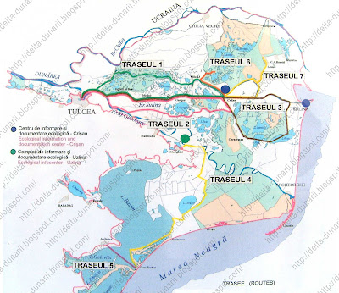
For the Danube Delta we have 19 routes:
Traseul nr. 1 Tulcea - Canalul Mila 35 - Girla Sireasa - Girla Sontea - Canalul Olguta - Dunarea Veche - Mila 23 sat - Crisan - Maliuc – Tulcea Traseul nr. 2 Tulcea - Canalul Litcov - Canalul Crisan - Caraorman - Hotelul Lebada - Maliuc - Tulcea Traseul nr. 3 Tulcea - Maliuc - Hotelul Lebada - Canalul Crisan - Caraorman - Lacul Puiu - Popas BTT Rosu - Lacul Rosu - Împutita - Canalul Busurca - Sulina – Tulcea Traseul nr. 4 Murighiol - Canalul Dunavat - Canalul Dranov - Golful Holbina - Lacul Razim - Gura Portitei Traseul nr. 5 Jurilovca - Gura Portitei Traseul nr. 6 Hotelul Lebada - Dunarea Veche - Canalul Eracle - Girla Lopatna - Canalul Lopatna - Lacul Trei Iezere Traseul nr. 7 Hotelul Lebada - Dunarea Veche - Canalul Magearu - Dunarea Veche - Bratul Sulina - Hotelul Lebada Traseul nr. 8 Traseul turistic Tulcea – Chilia Veche pe ruta: mun. Tulcea - canalele: Mila 36 – Sireasa – Sontea – Razboinita – Stipoc – Pardina - loc. Chilia Veche
Traseul nr. 9 Tur Chilia pe ruta: loc. Chilia Veche - brat Chilia - bratul Babina - bratul Cernovca - canal Sulimanca - Lacul Merheiu Mic - Lacul Merhei - Lacul Matita - Lacul Babina - canal Radacinoasele -canal Pardina -loc. Chilia Veche Traseul nr. 10 Tur Sf. Gheorghe pe ruta: loc. Sf. Gheorghe -canalele: Zaton – Buhaz – Palade –Crasnicol - bratul Sf.Gheorghe - loc. Sf. Gheorghe

Slide 6
Traseul nr. 11 Traseul turistic Sulina –Periprava, pe ruta: Sulina - can. Cardon - can. Sfistofca - Periprava Traseul nr. 12 Traseul turistic Sulina- Periprava, pe ruta: Sulina - can. Cardon - Golful Musura - bratul Musura - bratul Stambulul Vechi - brat Chilia – Periprava Traseul nr. 13 Tur Uzlina pe ruta: loc. Uzlina - can. Uzlina - lacurile: Uzlina si Isac - canal Isac 3 - gârla Perivolovca - brat Sf. Gheorghe - loc. Uzlina - cu extensie lac Isac- canal Isac 2- canal Litcov - canal Ceamurlia - can. Crisan - brat Sulina - Centru de Informare si Documentare Ecologica Crisan Traseul nr. 14 Traseul turistic Jurilovca – Periboina - Istria pe ruta: loc. Jurilovca - lacul Golovita - canal V - lacul Sinoe - cherhana Periboina - punctul Cetatea Istriei - canalul II - lacul Zmeica - lacul Golovita - loc. Jurilovca Traseul nr. 15 Traseul turistic Tulcea - Mila 23 pe ruta: mun. Tulcea - bratul Sulina - canal M.22 - garla Sontea - Dunarea Veche - loc. Mila 23 Traseul nr. 16 Traseul Crisan - Mila 23 pe ruta: loc. Crisan - Dunarea Veche - canal Bogdaproste - lacurile: Bogdaproste - La amiaza - Trei Iezere - garla Lopatna - canal Eracle - Dunarea Veche - loc. Mila 23 Traseul nr. 17 Traseul Sulina - Sf. Gheorghe pe ruta: oras Sulina - canalele: Busurca – Imputita - cordon litoral – Tataru - loc. Sf. Gheorghe Traseul nr. 18 Traseul Sulina – Sf. Gheorghe, pe ruta: oras Sulina: canal Busurca- canal Rosu – Imputita - lac. Rosulet - cherhana Rosulet - lac Rosu - baza turistica Rosu - lacul Puiu - can. Mocansca - lac Erenciuc - brat Sf. Gheorghe - loc. Sf. Gheorghe. Traseul nr. 19 Lac Casla- Garla Somova- Lac Potica- Lac Parches – Lac Telincea

Slide 7
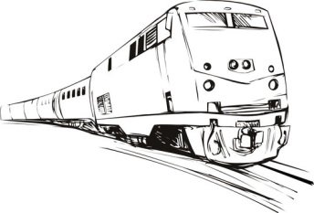
3. ACCESS
Access to the area can be done in multiple ways. Firs of all the main gates for entering the country are airports. For Romania, the most important airports for reaching Dobrogea region are the two airports from București, Interational Airport Henri Coandă and Băneasa Airport Aurel Vlaicu. The two main airports from Bulgaria, from which you can reach the main zone of this route are Varna Airport and Sofia Airport.
You can reach the Black Sea directly from the Danube, with the help of river boats, who can navigate until Sulina.
The Black Sea shore communicates with the rest of the area through the main roads transport axis, A2 and E772 from Sofia to Varna, on E87 and 39, E81, A4 along the shore of the Black Sea from Nessebar to Tulcea from where you can take the boat until Sulina. From Buchares until Constanta you can travel also to E81. You can travel on the railway from Bucharest to Constanța (226 km), and from Sofia to Varna. The boarder check point Bulgaria- Romania is in Vama Veche Point.
Ways to travel in Bulgaria and Romania
By plane:
Bulgarian international airports:
SOFIA - http://www.sofia-airport.bg
VARNA - http://www.varna-airport.bg
BURGAS - www.bourgas-airport.com
PLOVDIV - www.plovdivairport.com
Romanian international airports from Romania
BUCURESTI- Henri Coanda Airport - https://www.bucharestairports.ro/
BUCURESTI- Aurel Vlaicu Airport - https://www.bucharestairports.ro/baneasa/ro/
By Train
Although the railroad network is one of the most developed in Europe, trains are definitely not among the fastest. If you would like to travel shorter distance, it is better that you catch a bus. The advantage of railways is that they go through some really spectacular areas far from the main roads and motorways. Catching an international train is not recommended, esp. in the summer, because it is slower than the bus and is usually crowded.
By Taxi
Taxi is a relatively cheap way of transport but some taxis in the area of international airports and railway - as well as bus-stations, might have unreasonable prices! Ask on info-desks for recommended companies when taxi use is necessary or try to have a look at the price-list first (it is mandatory that the price-list is displayed on the front and right back window.)
By Bus
The two countries have a developed bus transportation system (both internal and external). What is more - travel costs here are among the cheapest in Europe. Bus lines connect major towns with almost all European countries.

Slide 8
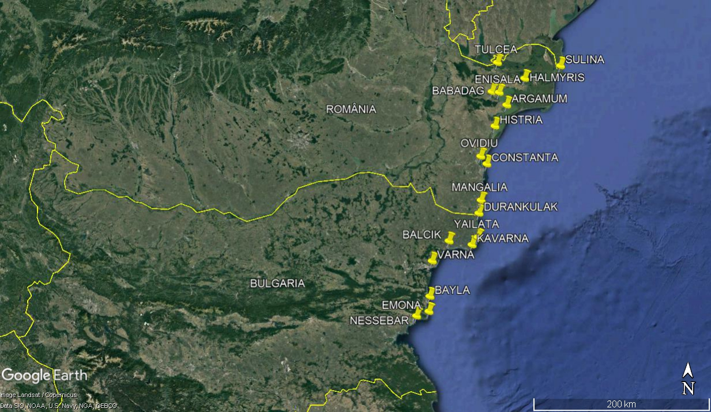

Slide 9
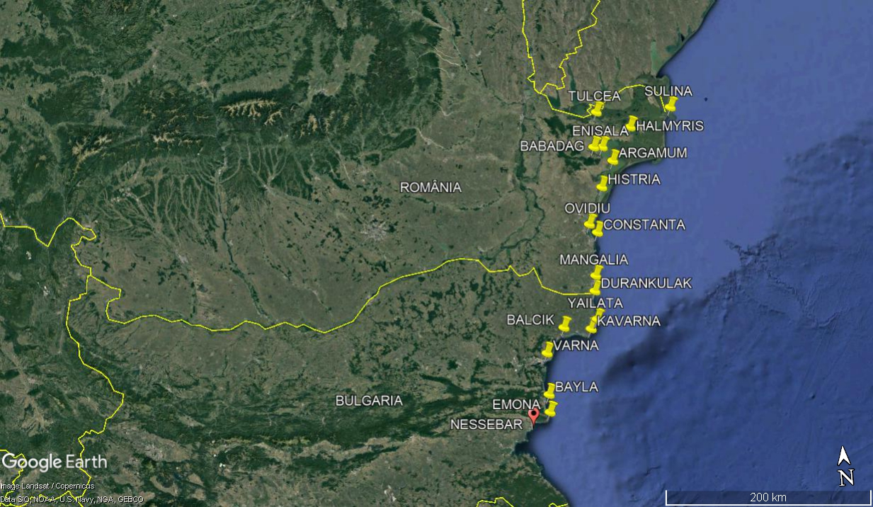
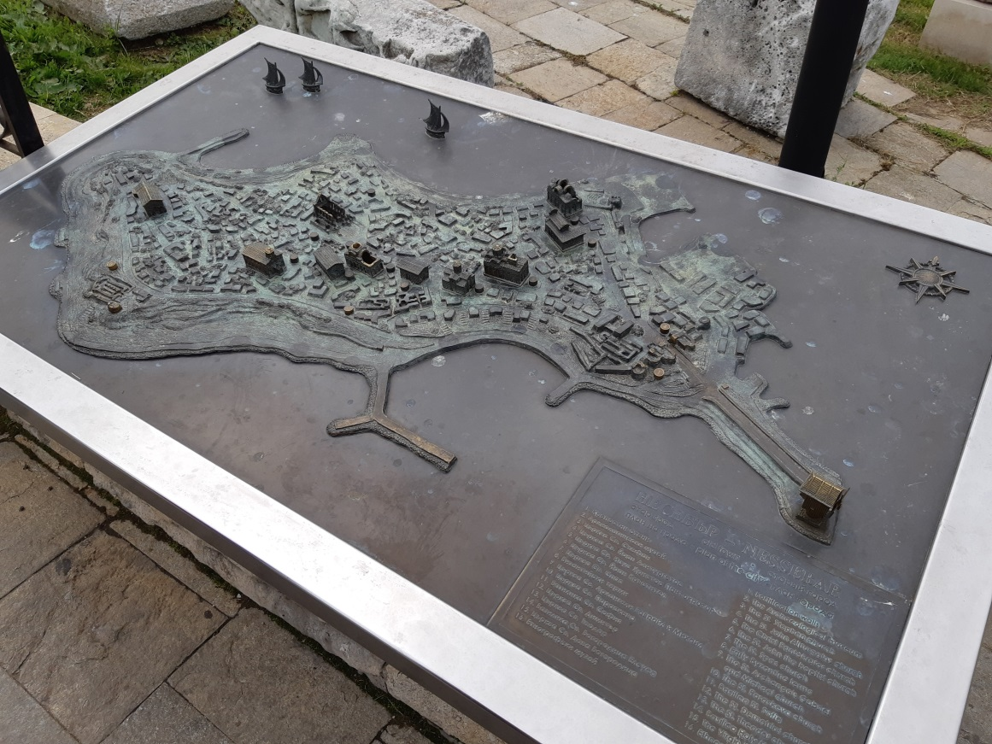
Archeological Sites and Museums
1. Nesebar

Slide 10
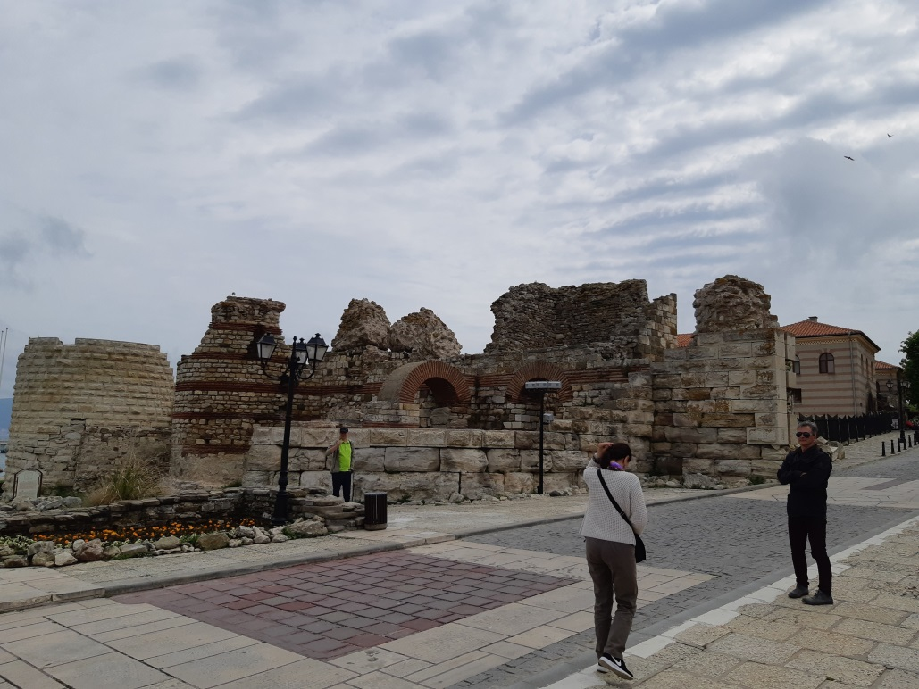
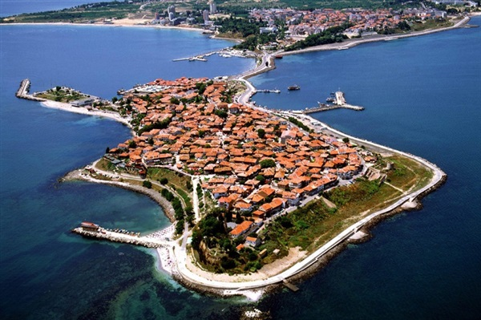
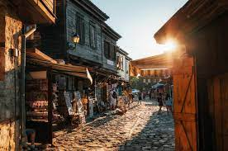
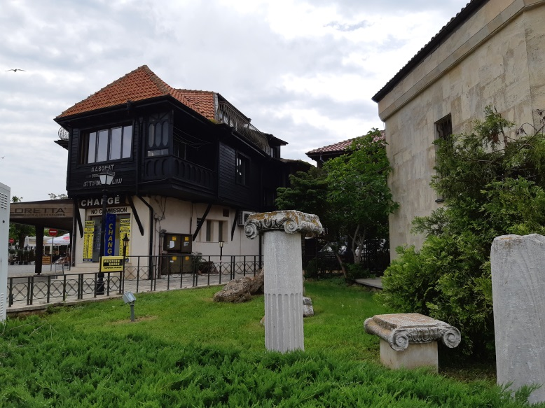
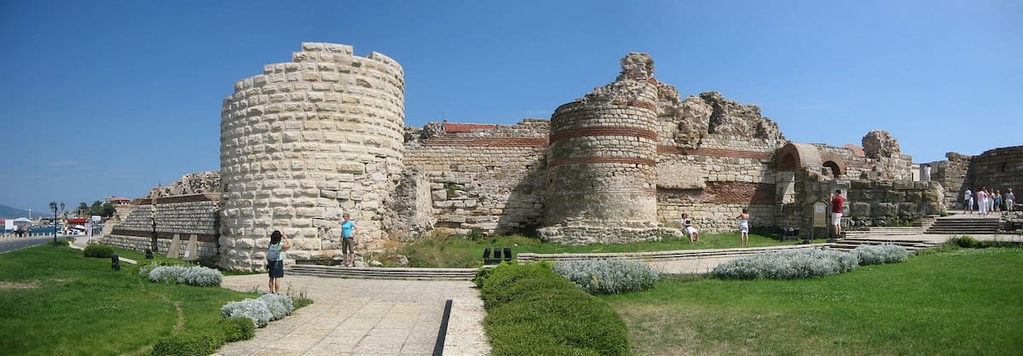
Archeological Sites and Museums
1. Nesebar

Slide 11
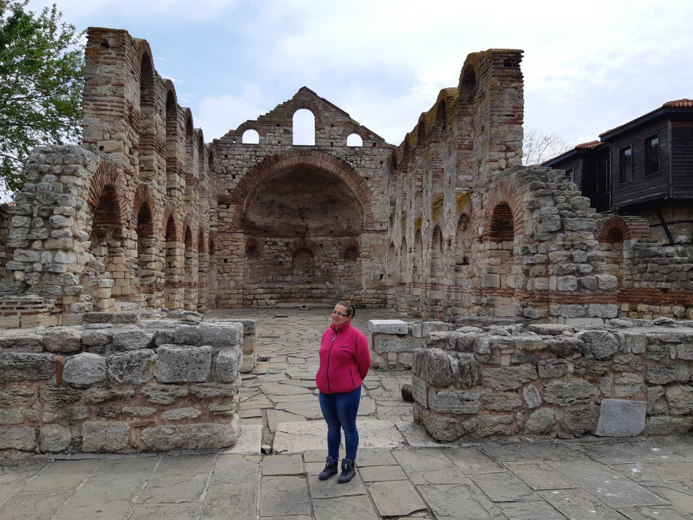
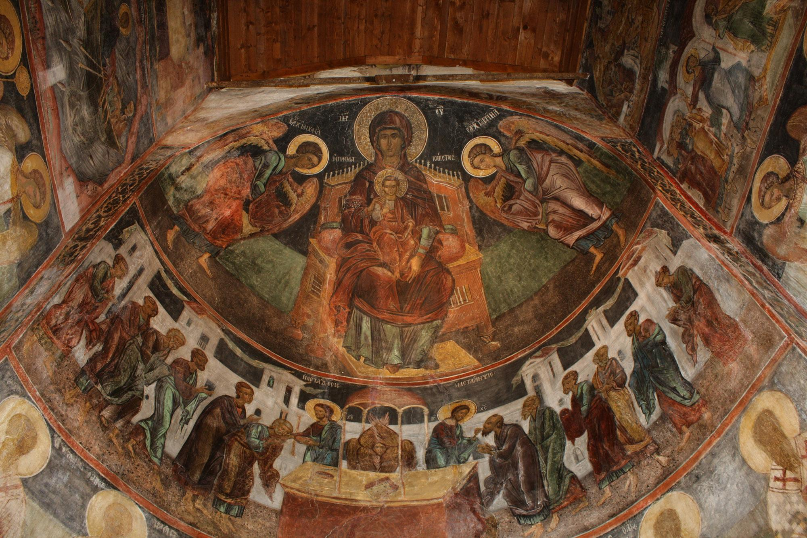
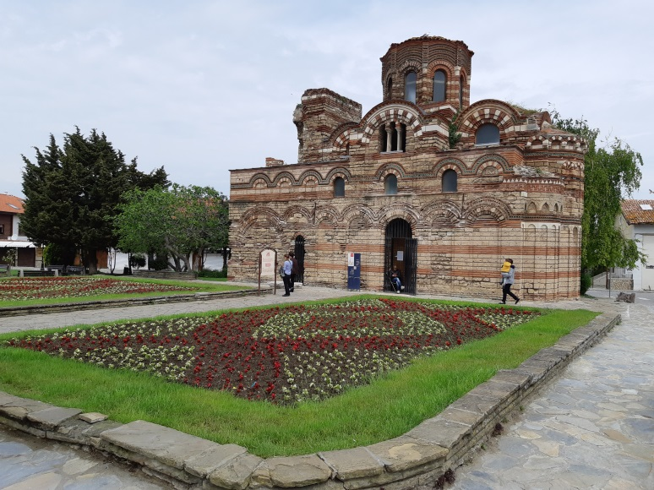
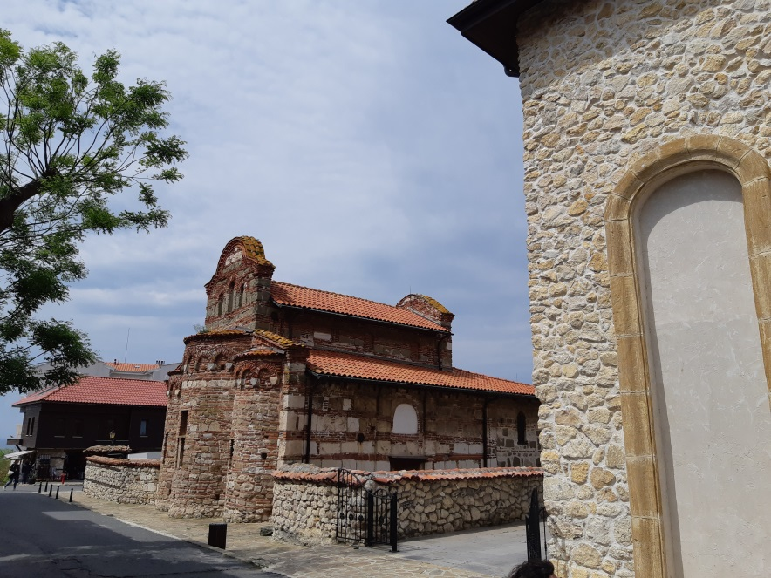

Slide 12
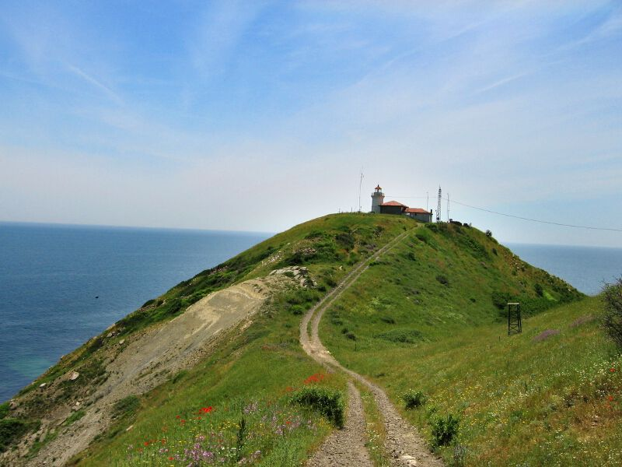
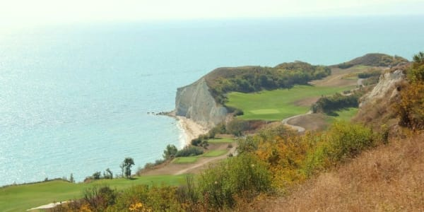
Archeological Sites and Museums
2. Emona

Slide 13
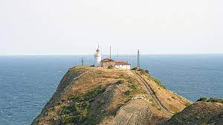
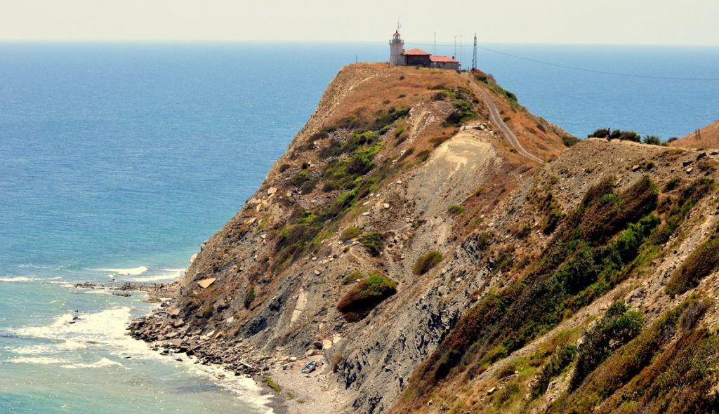
Archeological Sites and Museums
2. Emona

Slide 14
Archeological Sites and Museums
3. Byala

Slide 15
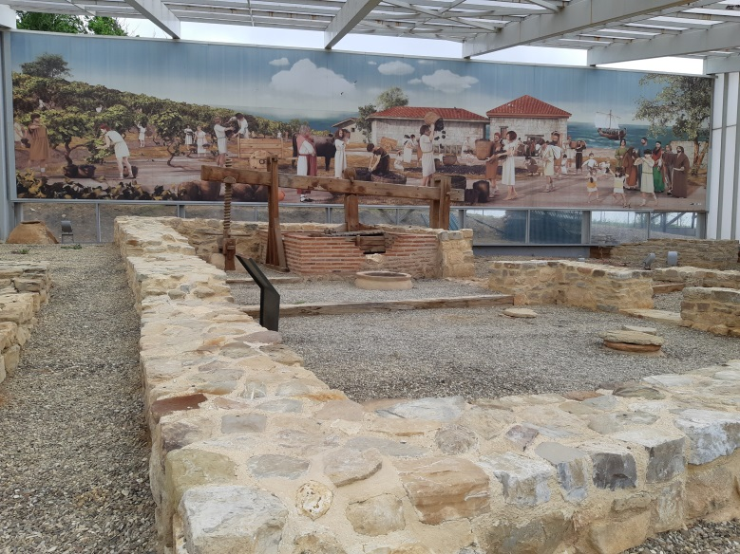
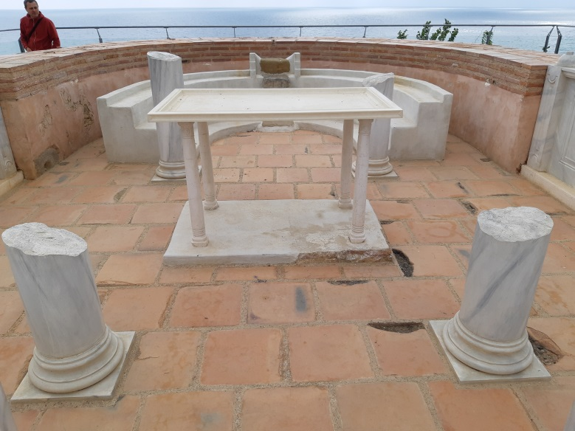
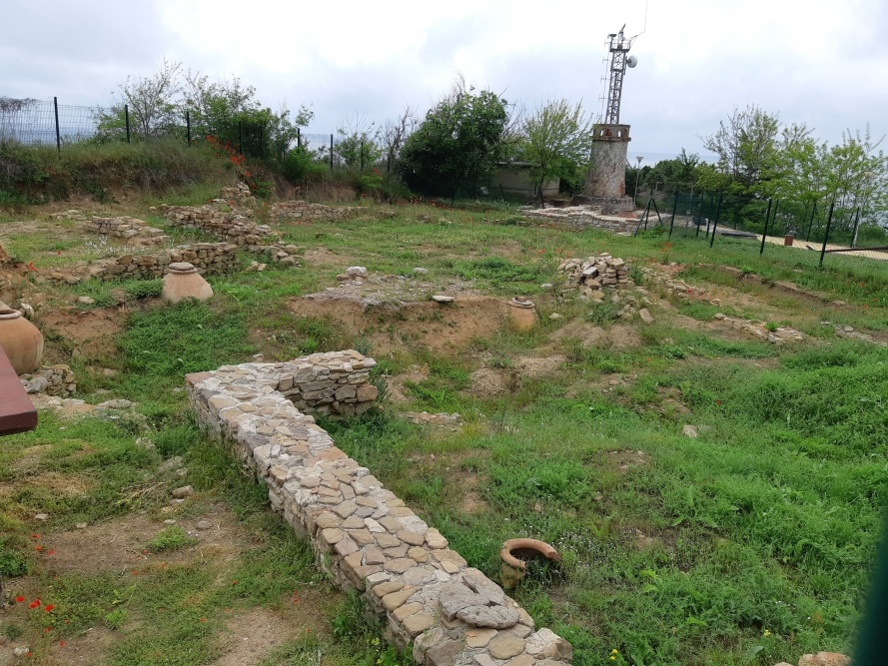
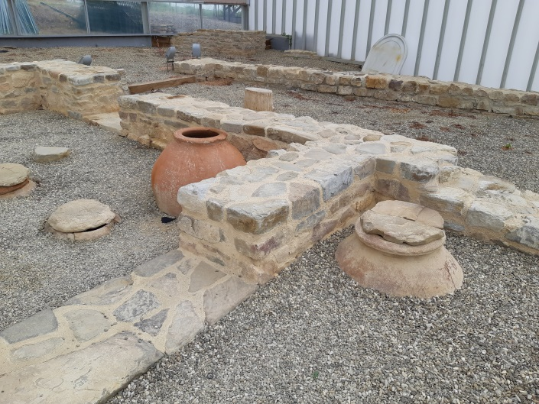
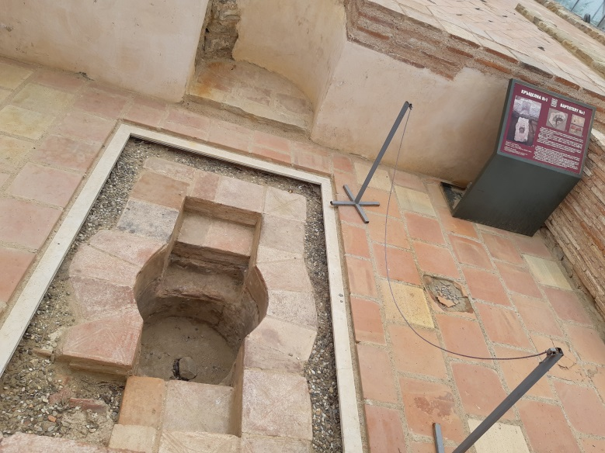
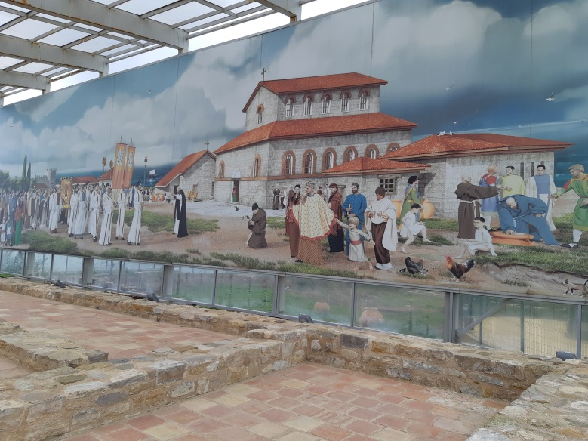
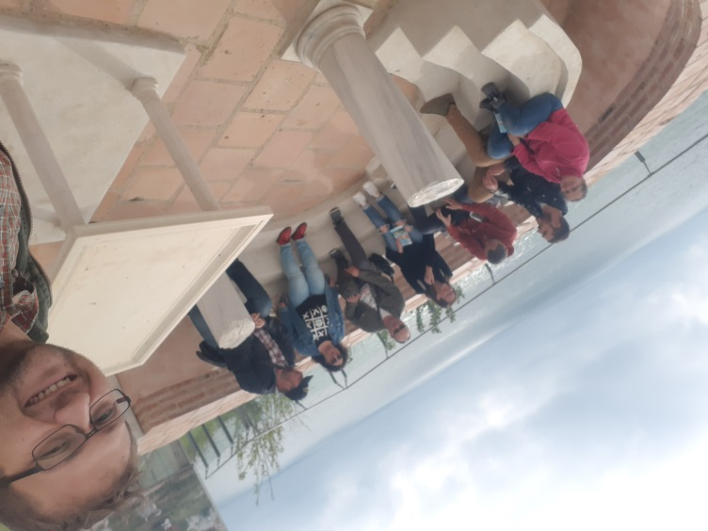
Archeological Sites and Museums
3. Byala

Slide 16
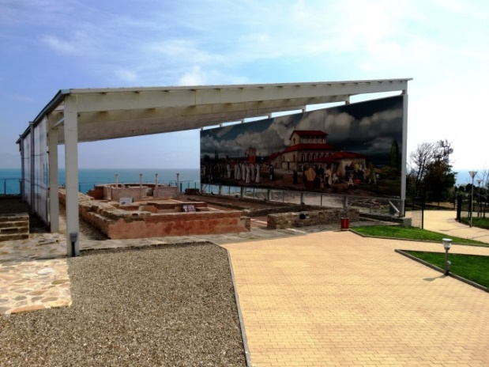
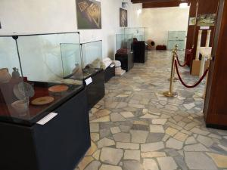

Slide 17
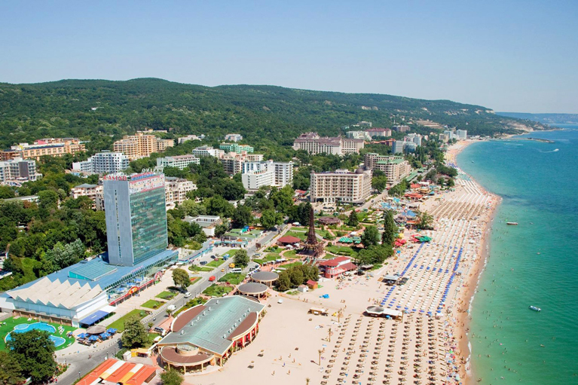
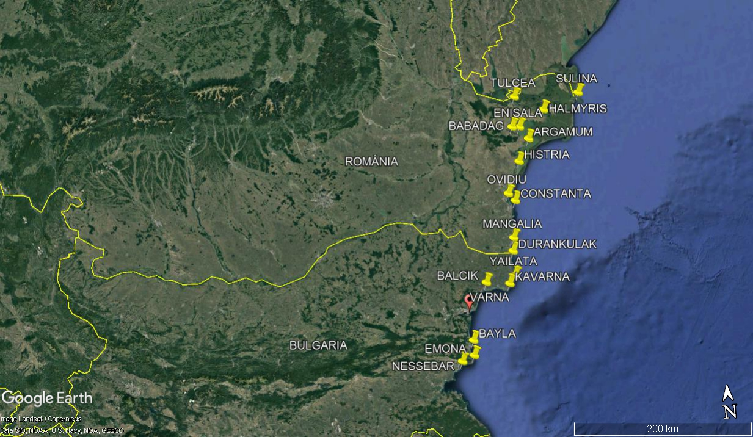
Archeological Sites and Museums
4. Varna

Slide 18
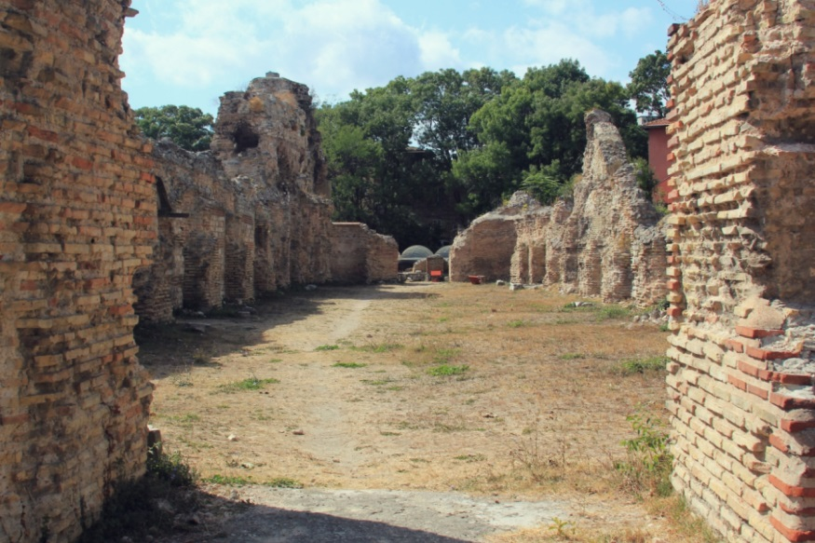
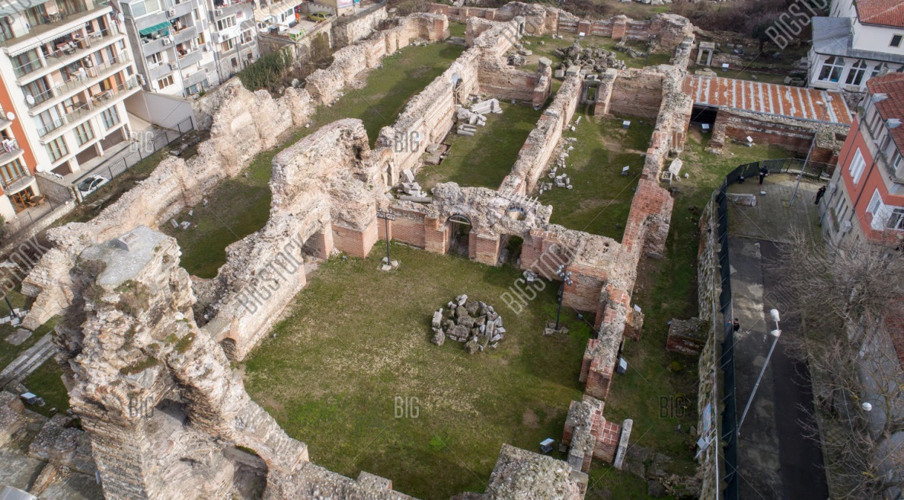
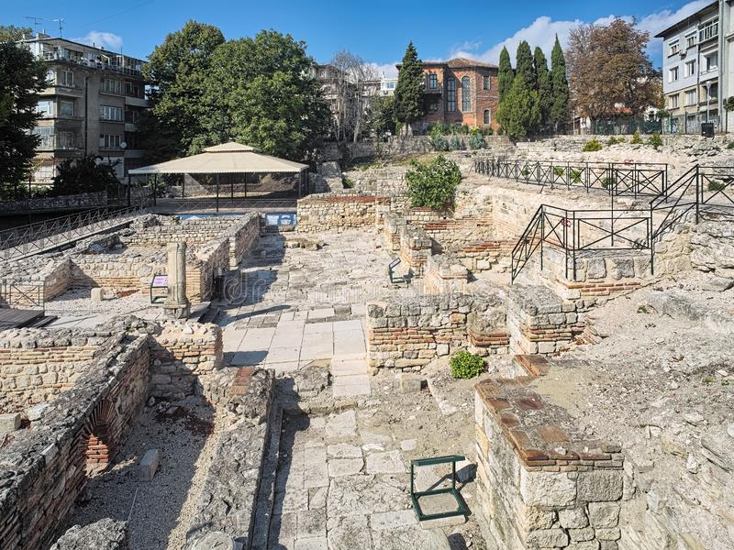
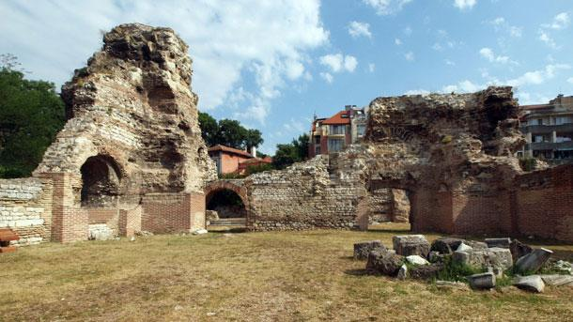
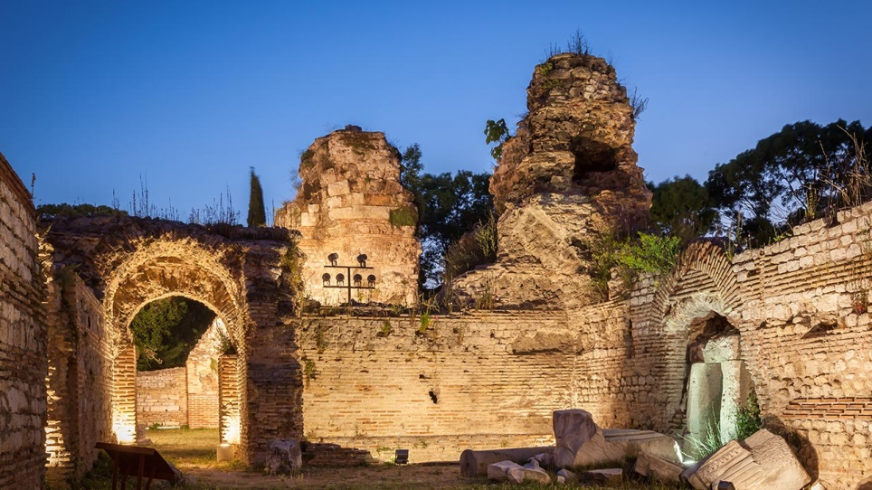
Archeological Sites and Museums
4. Varna

Slide 19
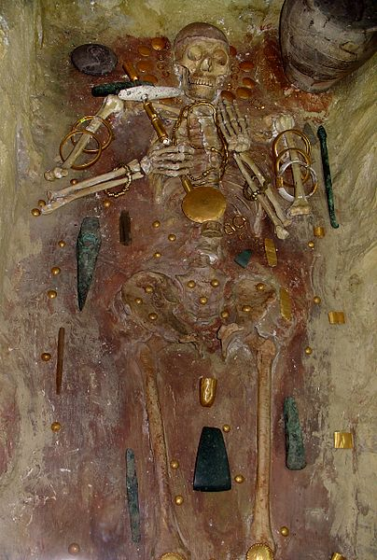
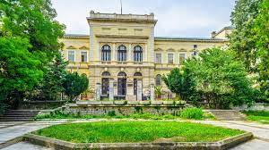
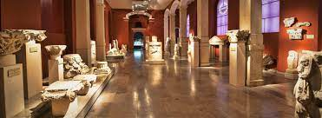
Archeological Sites and Museums
4. Varna

Slide 20
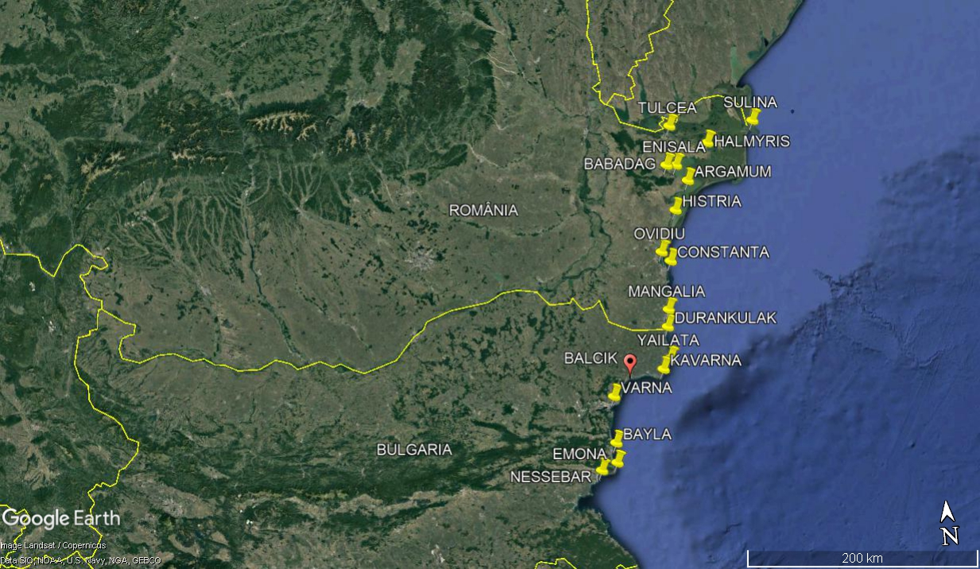
Archeological Sites and Museums
5. Balcik

Slide 21
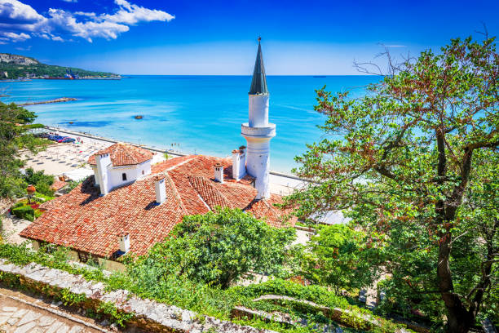
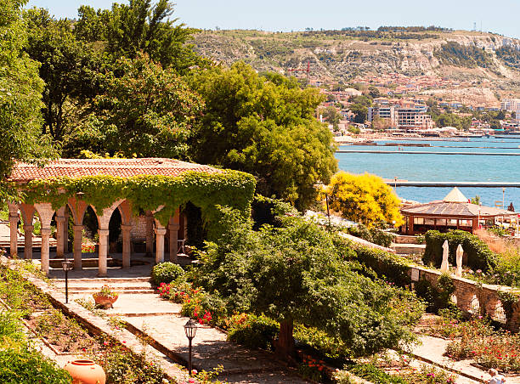
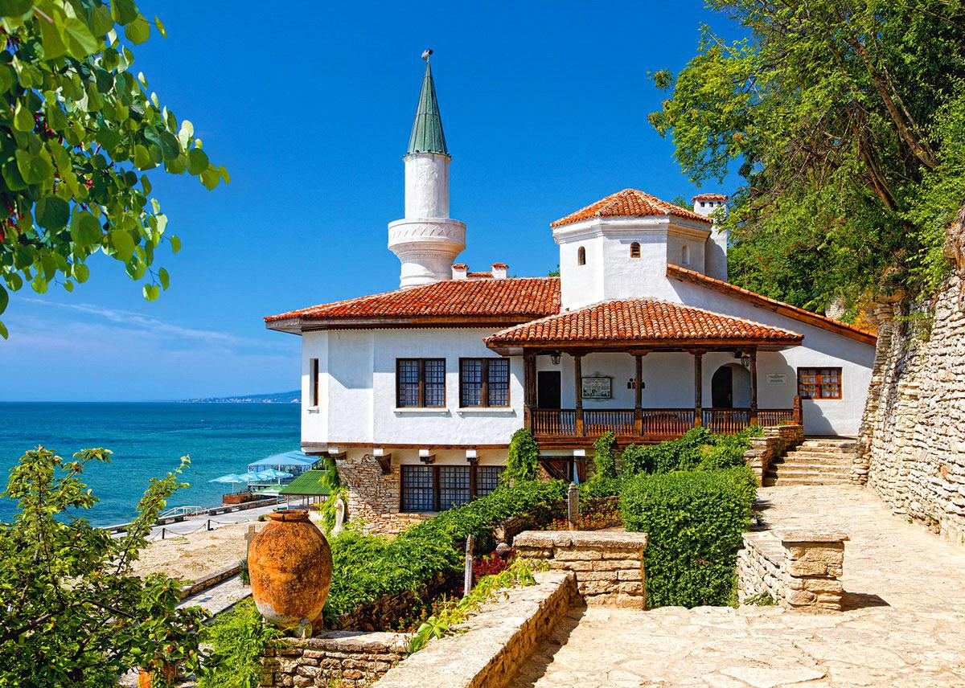
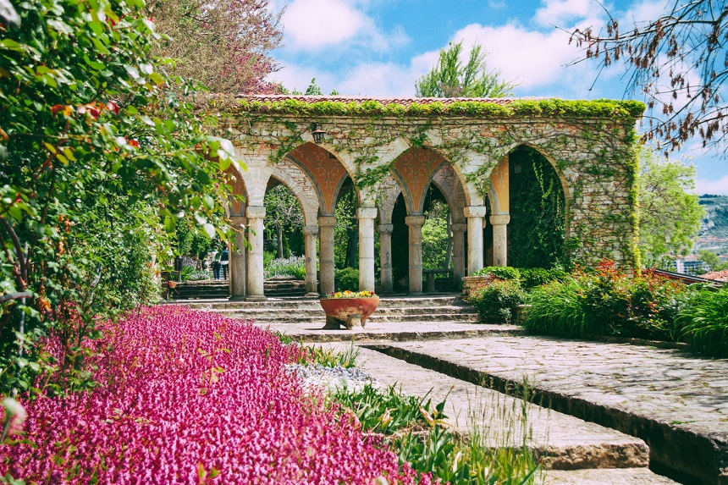
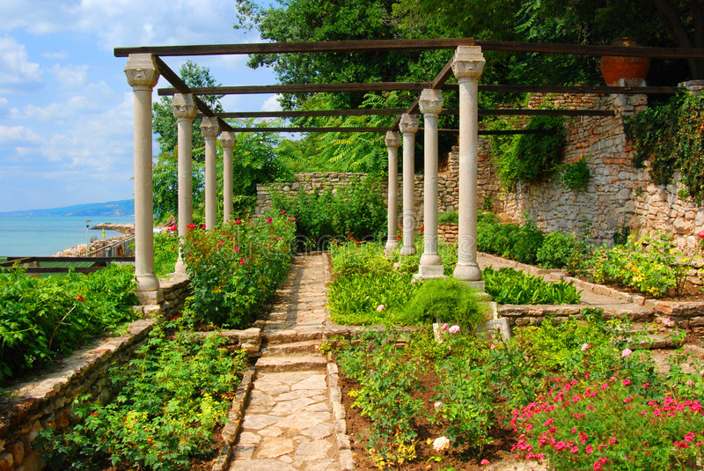
Archeological Sites and Museums
5. Balcik

Slide 22
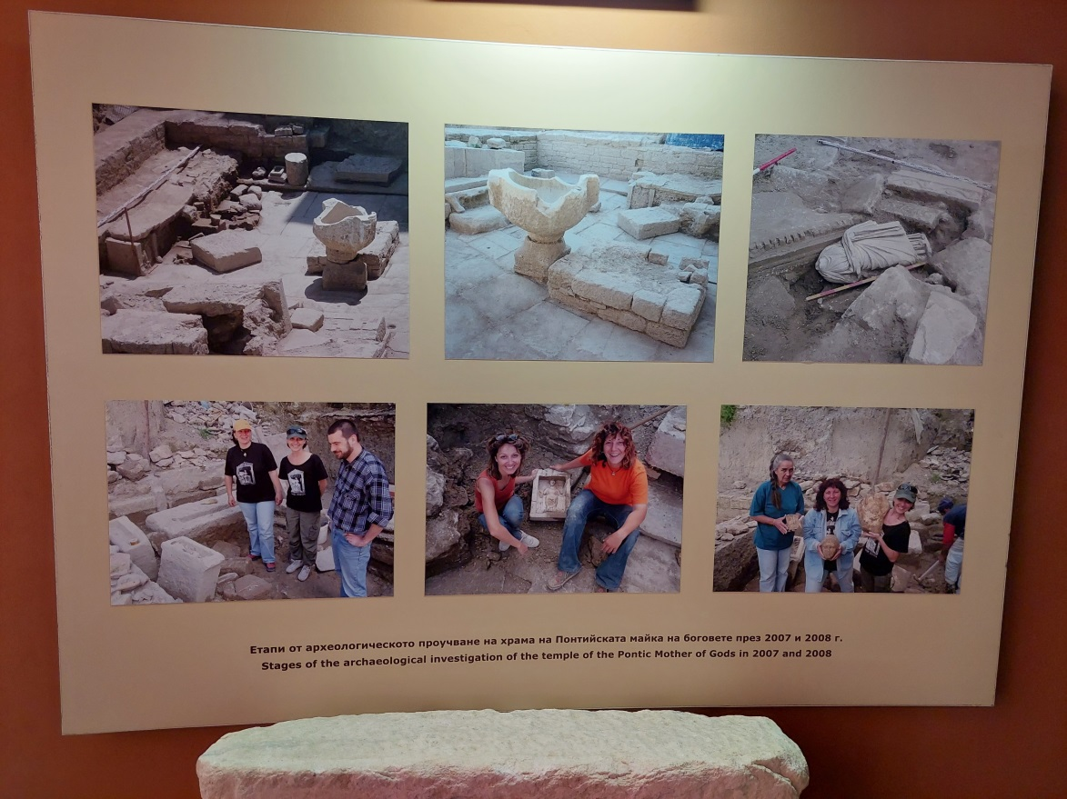
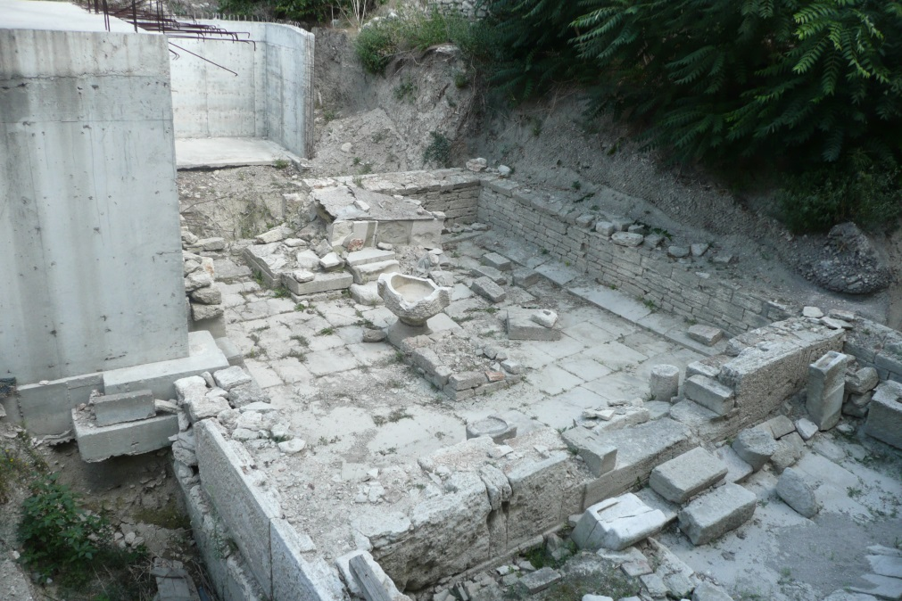
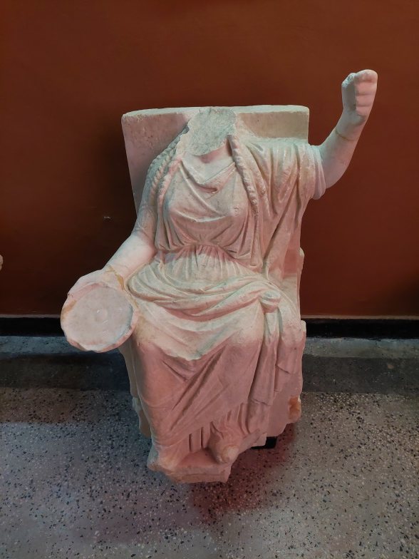
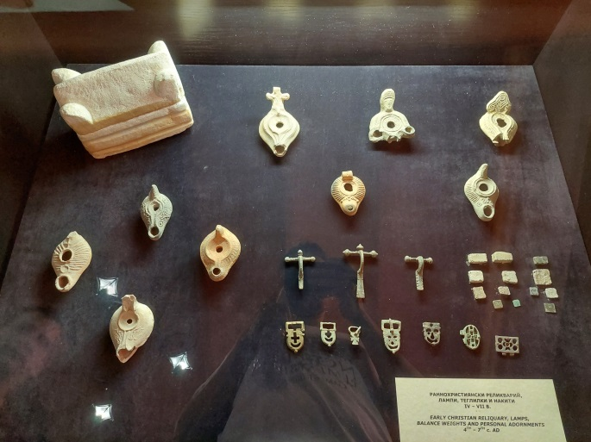
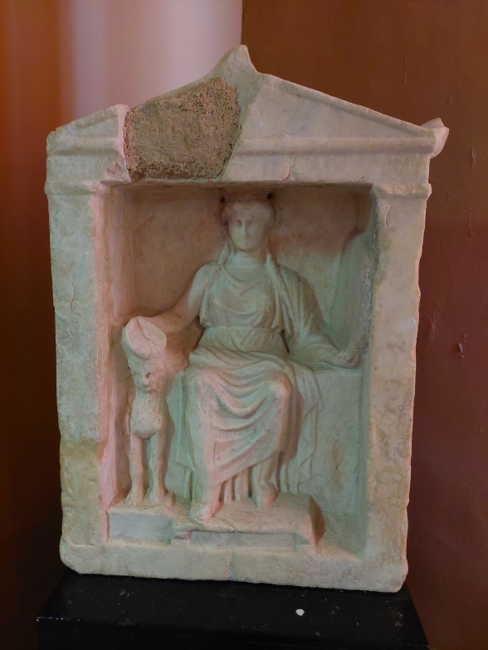
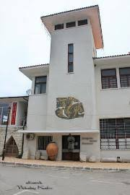
Archeological Sites and Museums
5. Balcik

Slide 23
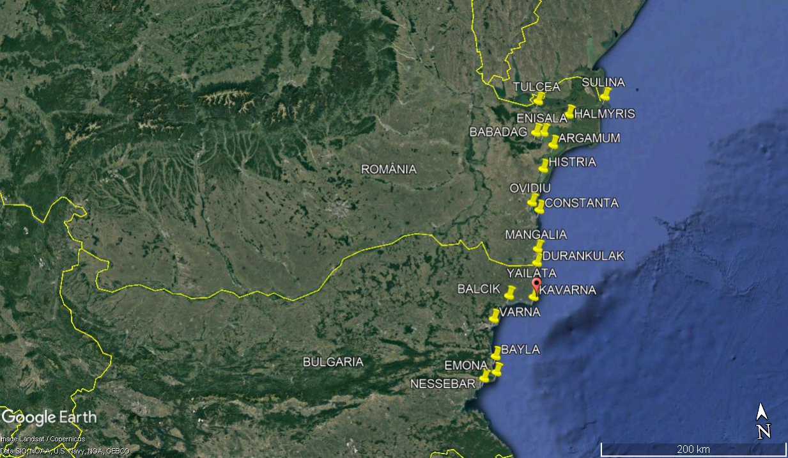
Archeological Sites and Museums
6. YAILATA and cavarna

Slide 24
Archeological Sites and Museums
6. YAILATA

Slide 25
Archeological Sites and Museums
7. Kavarna- Kaliakra

Slide 26
Archeological Sites and Museums
8. Durankulak

Slide 27
Archeological Sites and Museums
8. Durankulak

Slide 30
Archeological Sites and Museums
9. Mangalia- Callatis

Slide 31
Archeological Sites and Museums
9. Mangalia

Slide 32
Archeological Sites and Museums
9. Mangalia

Slide 34
Archeological Sites and Museums
10. Constanta

Slide 35
Archeological Sites and Museums
10. Constanta

Slide 36
The Roman City

Slide 37
Archeological Sites and Museums
10. Constanta

Slide 39
Archeological Sites and Museums
11. Ovidiu

Slide 40
Archeological Sites and Museums
11. Ovidiu

Slide 41
Archeological Sites and Museums
12. Histria

Slide 42
Archeological Sites and Museums
12. Histria

Slide 44
Archeological Sites and Museums
13. Enisala

Slide 45
Archeological Sites and Museums
14. Babadag

Slide 46
Archeological Sites and Museums
15. Murghiol/ Halmyris

Slide 47
Archeological Sites and Museums
16. Tulcea

Slide 48
Archeological Sites and Museums
17. Argamum

Slide 49
Archeological Sites and Museums
18. Sulina

Slide 50
Thank you for your attention!

